Slide 1
Learning To Count Object in Images
Victor Lempitsky, joint work with Andrew Zisserman
Visual Geometry Group, University of Oxford
Pattern Recognition and Computer Vision Colloquium
CMP Prague, October 2010

Slide 2
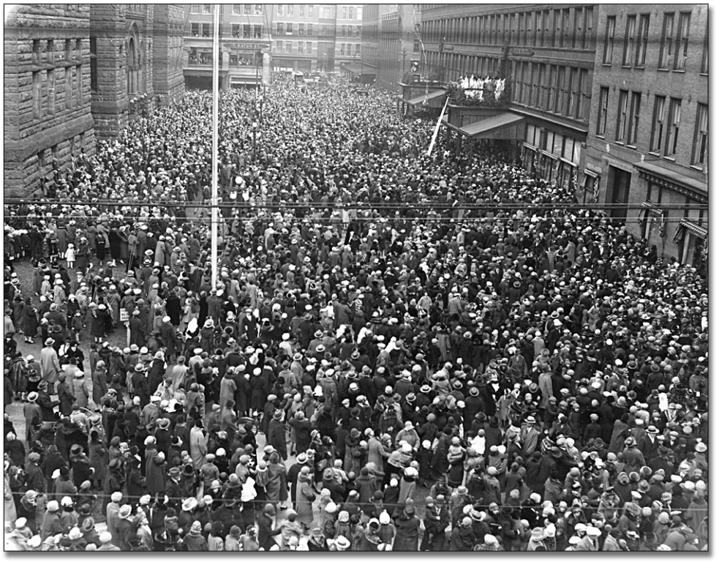
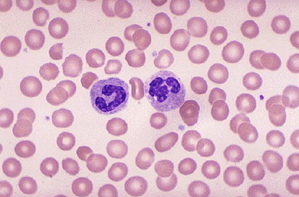
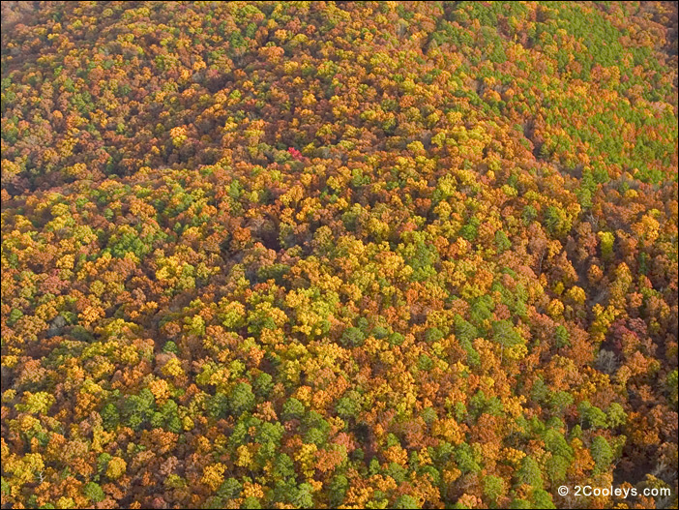
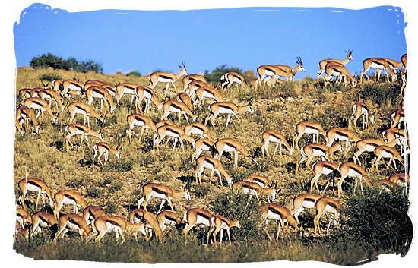
Counting tasks

Slide 3
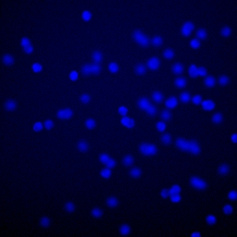
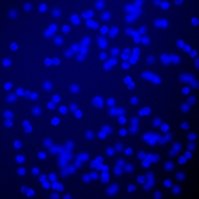
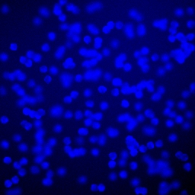
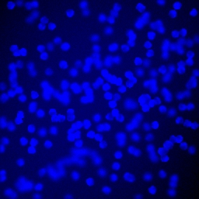
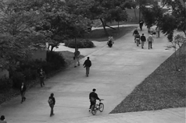
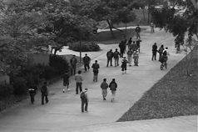
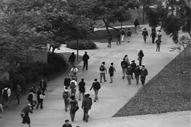
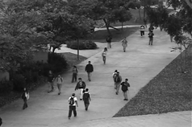
Example tasks for today
How many cells in each image?
How many people in each image?
Goal: machine learning-based approach to solve counting problems

Slide 4
Choosing annotation...
How many?
x
Totally unsupervised
Reporting numbers
Bounding boxes
Pixel-accurate
Dotted annotation
...arguably minimal for humans
...containing much more information than just numbers
x
x
x
x
x
x
x
x
x
x
x
x
x
x
x
x
x
x
x
x
x
x
x
x
x
x
x
x
x
x
x

Slide 5
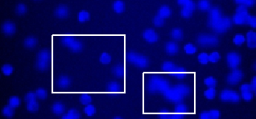
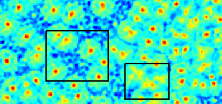
Baseline 1: “Counting-by-Detection”
Train time: learn a detector, i.e. a sliding window classifier
Test time: apply detector, then use non-maximum suppression to find objects
Fragile when objects overlap
6
6
10
?
input
detector output
Other detection-based schemes: generative methods, morphological analysis. [Zhao&Nevatia CVPR’03, Dong et al. ICCV’07, Wu et al. CVPR’08, Descombes et al. JMIV’09, Anoraganingrum IAP’99, Selinummi et al. Biotechniques’05]
Problem: strict assumptions about the objects, slow and fragile inference.
High-level problem: trying to solve a (much) harder problem than we are asked for

Slide 6
Baseline 2: “Counting-by-Regression”
Let us solve exactly the same problem we are asked to solve:
200
Regression
100
numbers
Images
Global representations
Problem: one image = one training sample
Wasteful!
[Marana et al. Im. Proc. for Security App. ‘97], [Cho et al. IEEE TSMC’99], [Kong et al. ICPR’06]

Slide 7
Improving “Counting-by-Regression”
x
x
x
x
x
x
x
x
x
x
x
x
x
x
x
x
x
x
x
x
x
x
x
x
x
x
x
x
x
x
x
x
One way to describe our method
Two ways to improve:
Sample subwindows to get more training examples
Segment objects into groups, and do regression for each group
[Chan et al CVPR’08, Ryan et al. DICTA’09]

Slide 8
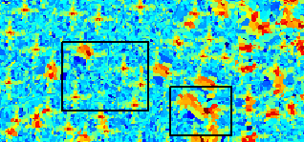
Counting via Estimating the density
6
6
10
?
input
detector output
Key idea: learn to estimate a continuous-valued density.
6.5
9.4
density estimate

Slide 9
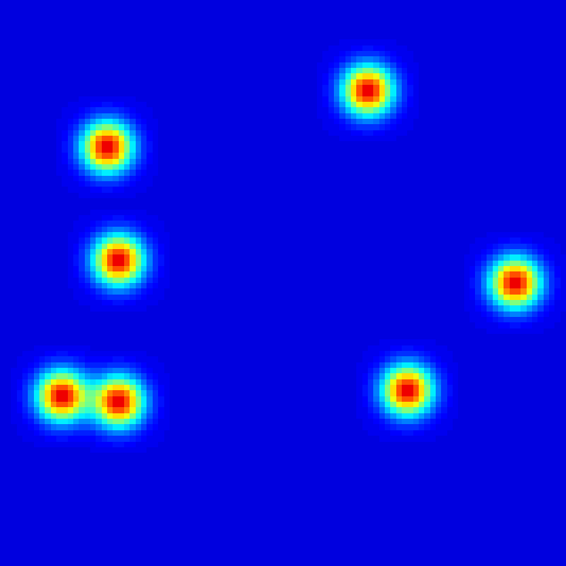
“Ground truth” density
– the set of training images.
– the set of dots for i-th image.
“Ground truth” density:
Bayesian interpretation: probability of the user putting a dot at a particular place (if asked to re-annotate the data)
Observed
x
x
....
True

Slide 10
Estimating density
“Ground truth” density:
Each pixel is described by a feature vector, e.g. VQ appearance descriptor:
Other variants:
Soft-assignment quantization
Multiple codebooks (e.g. Randomized trees):
Estimated density:
the weight vector to be learned
feature vector describing pixel p in image i

Slide 11
Regularized risk learning
“Ground truth” density:
Estimated density:
Regularized risk learning:
regularization
risk

Slide 12
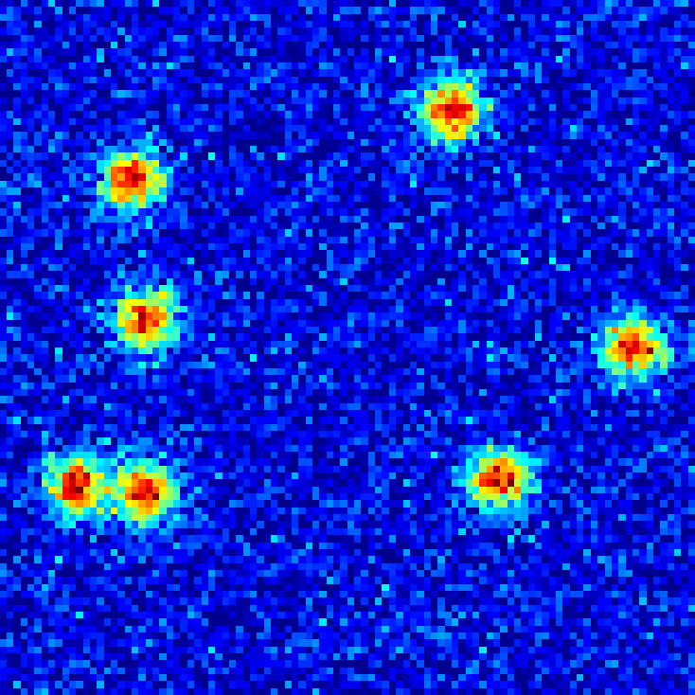
“Baseline” choices for distances
Pixel-wise distance, e.g.
Problem:
very good match for our needs
...yet very far apart
Whole-count distance, e.g.
Problem: we are back to counting-by-regression

Slide 13
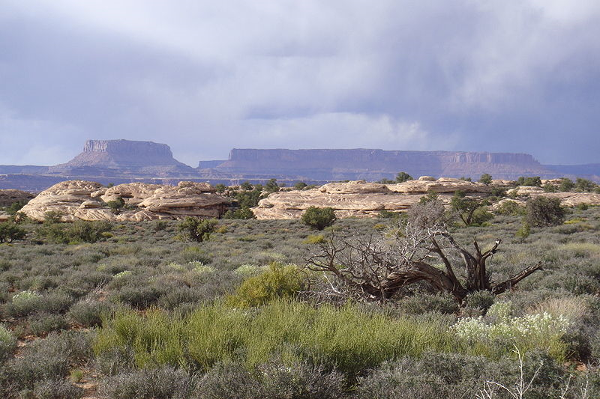
MESA-distance
Whole-count distance:
Our proposal – MESA distance:
Set of all box sub-arrays of the image
MESA = Maximum Excess on Sub-Arrays
Wikipedia: A mesa (Spanish and Portuguese for "table") is an elevated area of land with a flat top and sides that are usually steep cliffs.

Slide 14
MESA-distance
Possible interpretation:
Map each density to a huge vector encoding all sums on sub-arrays
MESA-distance = L∞ distance in the new space
Properties:
“looks” at all rectangles,
upper-bounds the whole-count distance
insensitive to local perturbations, sensitive to global layout change

Slide 15
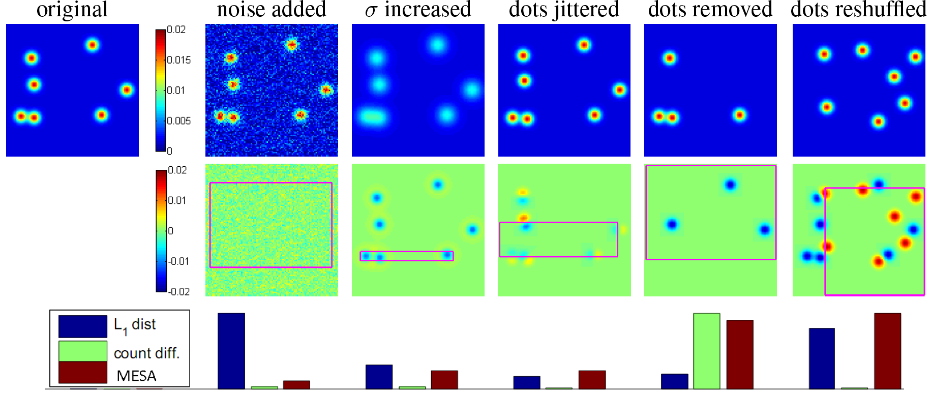
MESA-distance: examples

Slide 16
How to compute MESA-distance?
2D Maximum Subarray Problem
2D Maximum Subarray Problem

Slide 17
Kadane’s algorithm
Task: 1D maximum sub-array – finding the maximal sum over contiguous subarray.
Complexity: just one pass over the array (dynamic programming)
5 | - 4 | 3 | 4 | -10 | 5 | 6 | 7 | -20 | 7
Input:
Best sum ending here (truncated at 0):
5 | 1 | 4 | 8 | 0 | 5 | 11 | 18 | 0 | 7
Best so far:
5 | 5 | 5 | 8 | 8 | 8 | 11 | 18 | 18 | 18
[ Bentley, Comm.ACM’84]

Slide 18
Maximum subarray in 2D
Task: finding the maximal sum over contiguous sub-array of a 2D array.
Complexity: easy to achieve O(N^{1.5}), but hard to get much better (for worst-case)
Solution for O(N^{1.5}) [Bentley, Comm.ACM’84]: exhaustive search over smaller dimension ⦻ Kadane’s algorithm over longer side (+integral sums).
Faster average case solution: replace exhaustive search with branch-and-bound [An et al. CVPR’09]

Slide 19
How to compute MESA-distance?
2D Maximum Subarray Problem
2D Maximum Subarray Problem
Complexity: can be done in O(N^{1.5}) – worst case. Under 1 second in practice.
MESA-distance properties:
“Looks” at all rectangles
Upper-bounds the whole-count distance
Insensitive to local perturbations, sensitive to global layout change
Fast to compute

Slide 20
Optimization program
Can be posed as the following optimization program:

Slide 21
Optimization program
Convex, quadratic program
Huge number of constraints
Solvable via a cutting plane method akin to structural SVMs [Joachims et. al 2009]

Slide 22
Cutting plane optimization
Active set of boxes
Iterate:
Solve the program.
For the current optimal w, find the most violated constraints
For each image add the “most violated” boxes to the active sets.
Initialization: small random subset of boxes in each active set
Termination: all constraints are satisfied upto a small ε (e.g. 0.01)

Slide 23
Finding most violated constraints
max over B
2D maximum subarray problems
max over B

Slide 24
Summing up
At train time:
Compute feature vector for each pixel in each training image
Solve
Store the w vector
At test time:
Compute feature vector for each pixel in a test image
Compute density
Sum the density over any region of interest, e.g. full image

Slide 25
Application 1: cell counting
Data source: a tool for synthesizing realistic fluorescence microscopy images of bacterial cells by [Lehmussola et al.// Transactions on Medical Imaging 2007]
Big variation in numbers: 74 – 317 cells per image
Feature mapping: local SIFT quantized to 256 words.
Ground truth density: σ = 0 and σ = 4 lead to very similar accuracies.

Slide 26
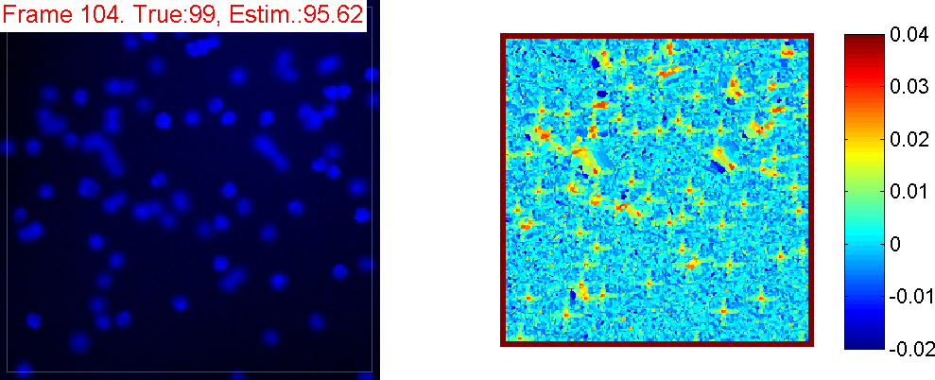
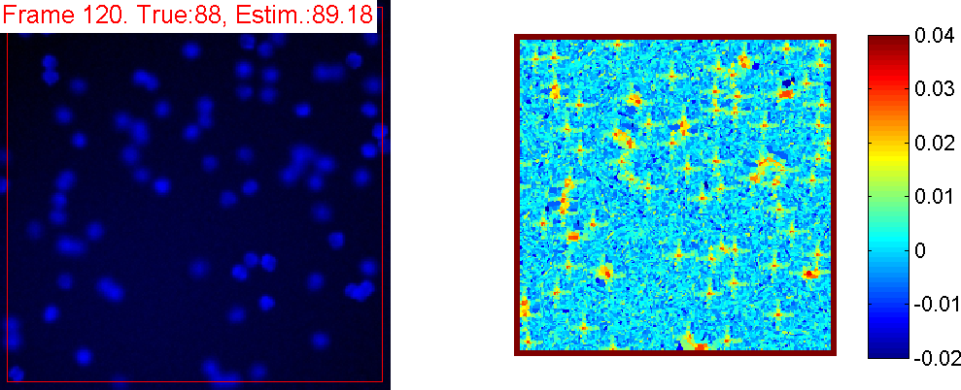
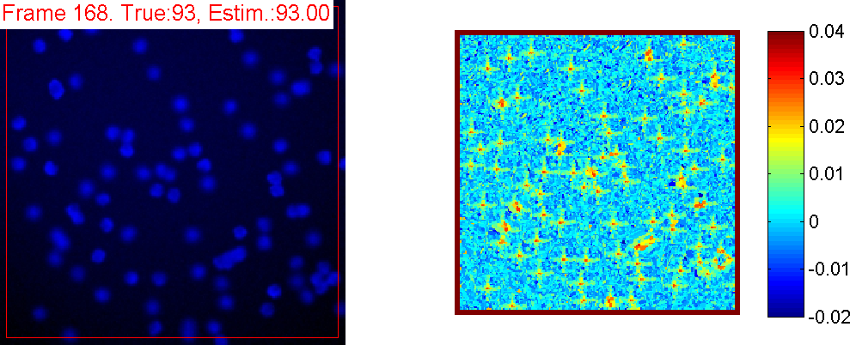
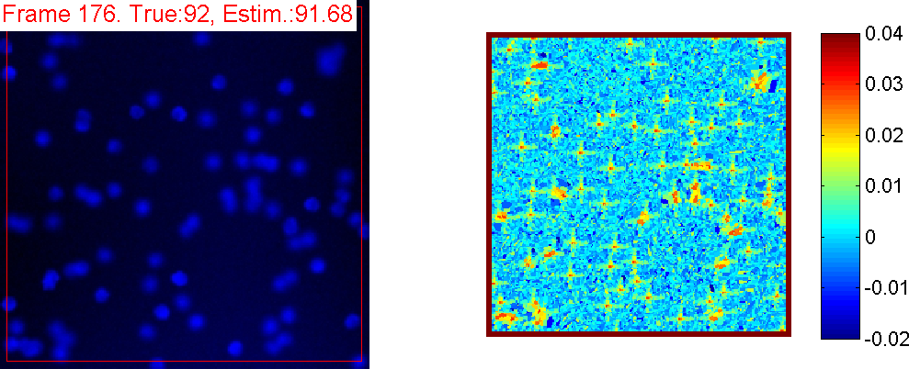
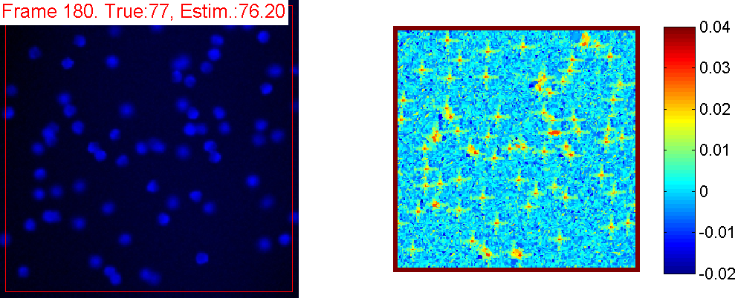
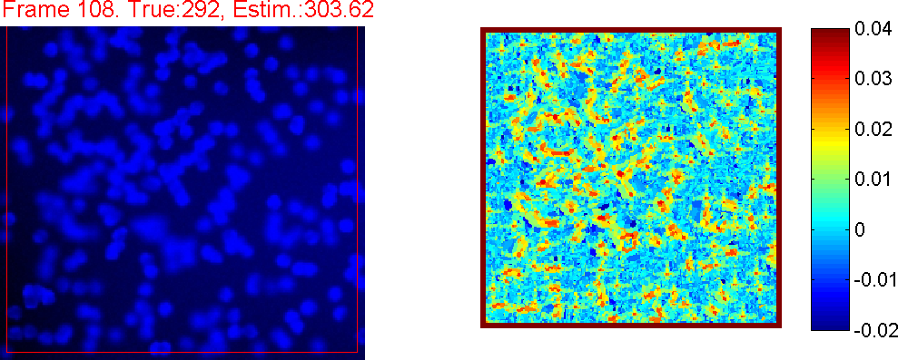
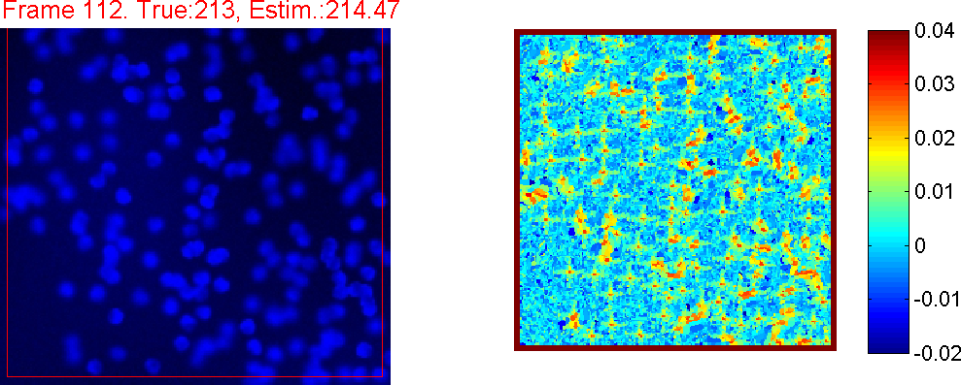
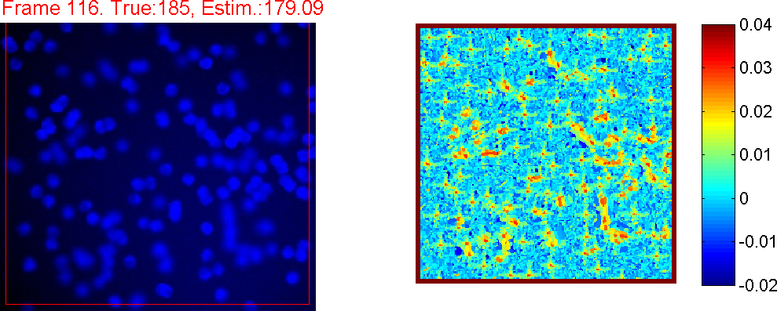
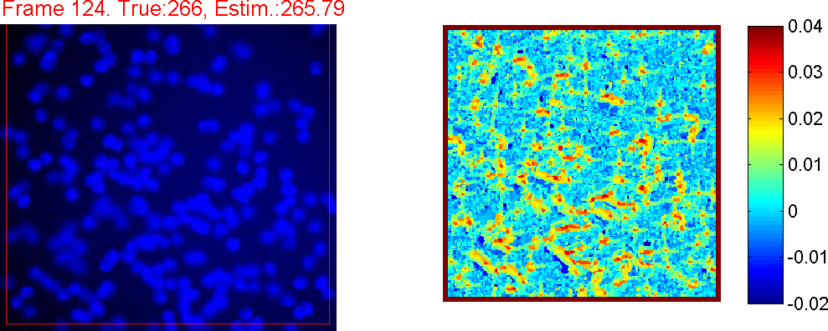
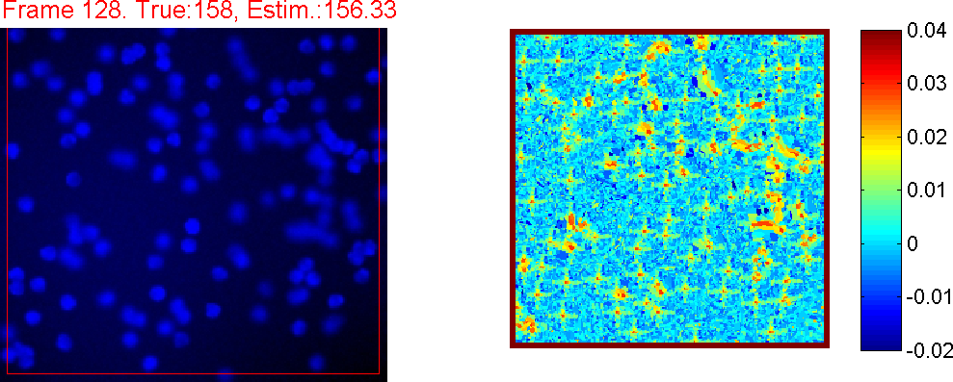
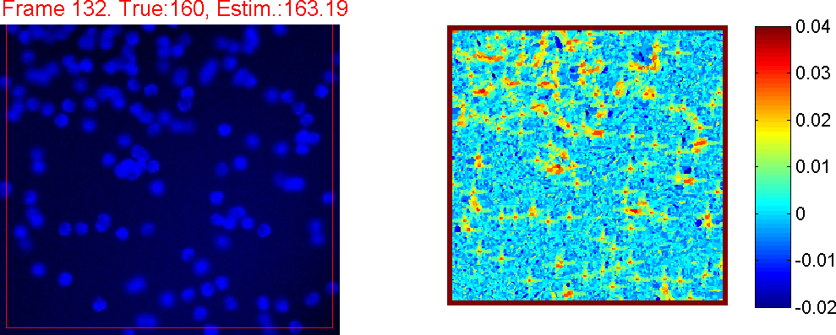
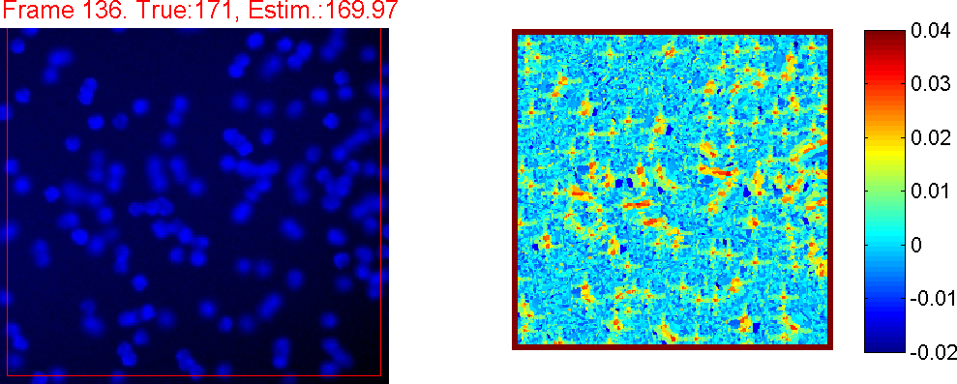
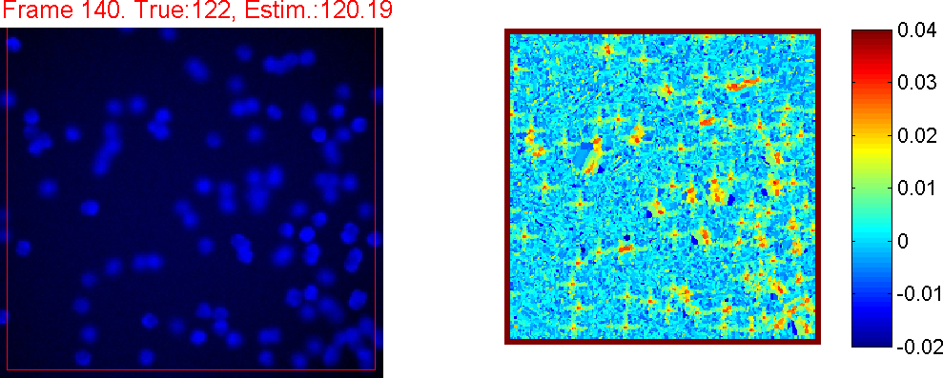
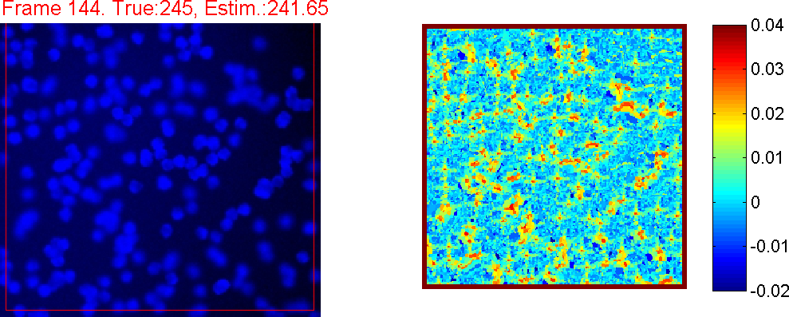
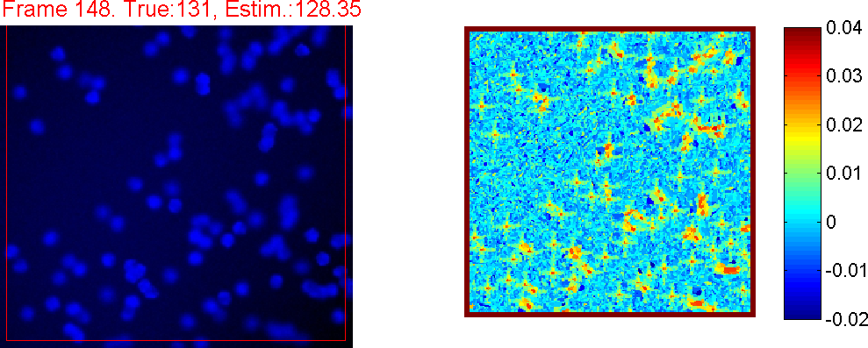
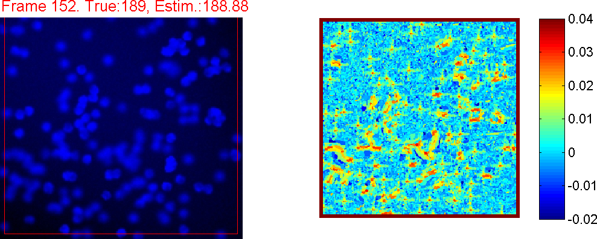
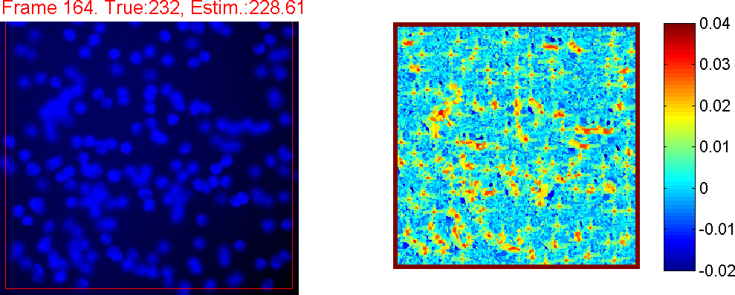
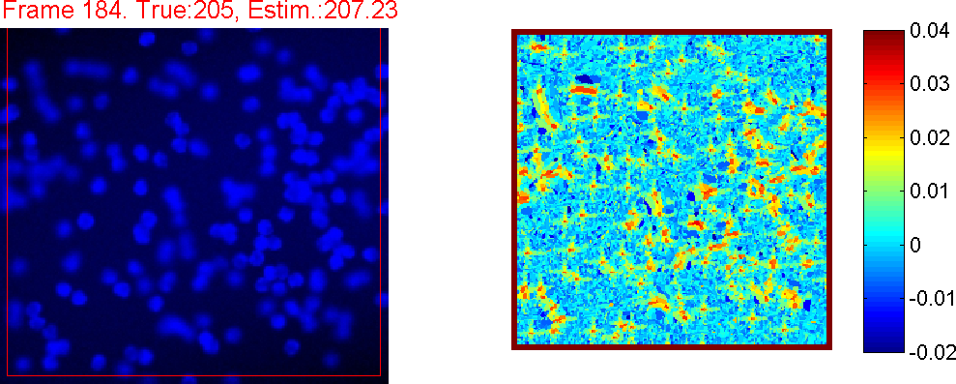
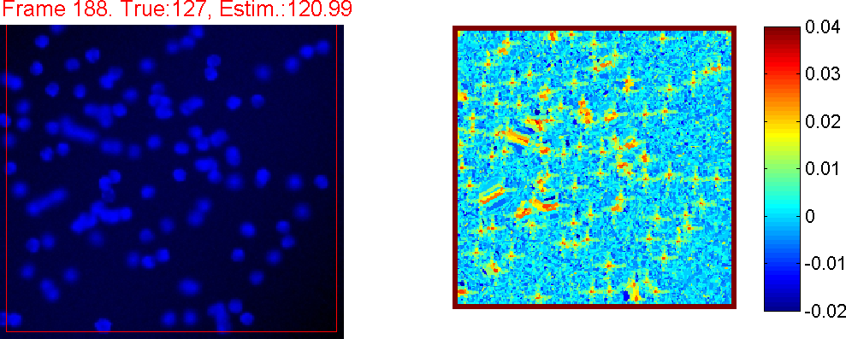
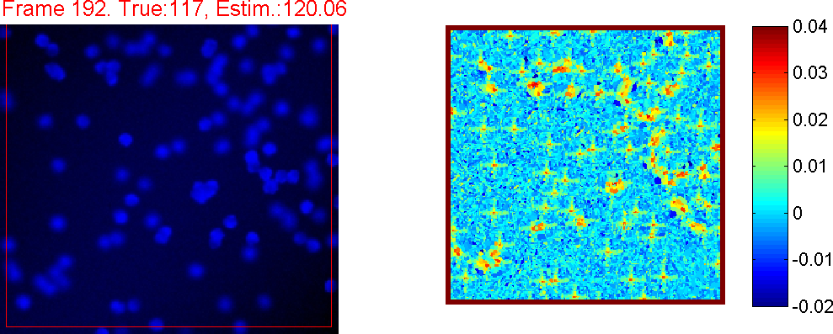
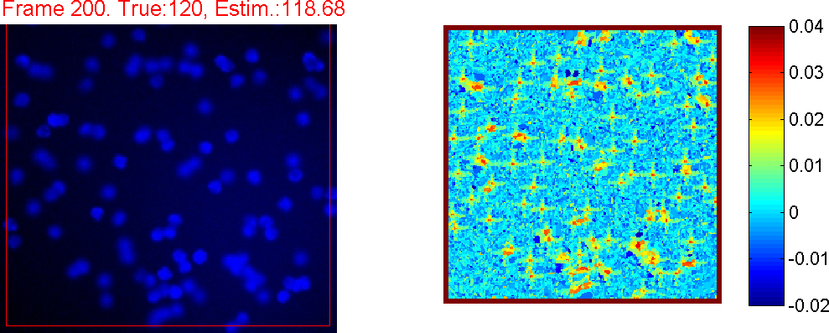
Qualitative results
Uniform sampling of the test dataset:
Count estimated by our method
Ground truth count

Slide 27
Quantitative comparison
Experimental protocol:
Use the same features SIFT with the same quantization (if appropriate) for all methods.
Use N images for learning the main set of parameters.
Use another set of N images for the validation of hyper-parameters
Repeat for 5 different training and validation sets
Report mean absolute error for a hold out set of 100 images

Slide 28
Comparison results for cell counting
Counting-by-detection: trained detector + non-maximum suppression
Counting-by-regression
(no sub-images sampled)
Mean absolute counting error on the held-out set
Adding a constraint w ≥ 0 during learning
Outcome: proposed method uniformly better for all N
[Selinummi et al. Biotechniques’07] morphological analysis tuned for this imagery: 16.2

Slide 29
Accuracy for cell counting
True vs estimated count on the test set (N = 32):
Observation: accuracy is uniformly good over the entire range

Slide 30
Application 2: pedestrian counting
How many people in each image?
Data: a single dot-annotated sequence of 2000 frames from San-Diego. Published in [Chan, Liang, and Vasconcelos. // CVPR, 2008]
Feature mapping: 5 randomized trees with tests on grayvalue, derivative values, difference and absolute difference with the background image (obtained through a simple median filter).
Extra information: ground plane + region of interest.
Nullify features and GT density outside ROI
Multiply features by the inverse squared depth

Slide 31
Experimental comparison
Use a set of splits proposed in [Ryan et al. DICTA’09].
Training frames/span range 161 /800 80/395 80/395 10/720 80/400 10/400
Outcome: proposed method on a par with [Ryan et al. DICTA’09].
...but [Ryan et al. DICTA’09] used significant amount of additional annotation.

Slide 32
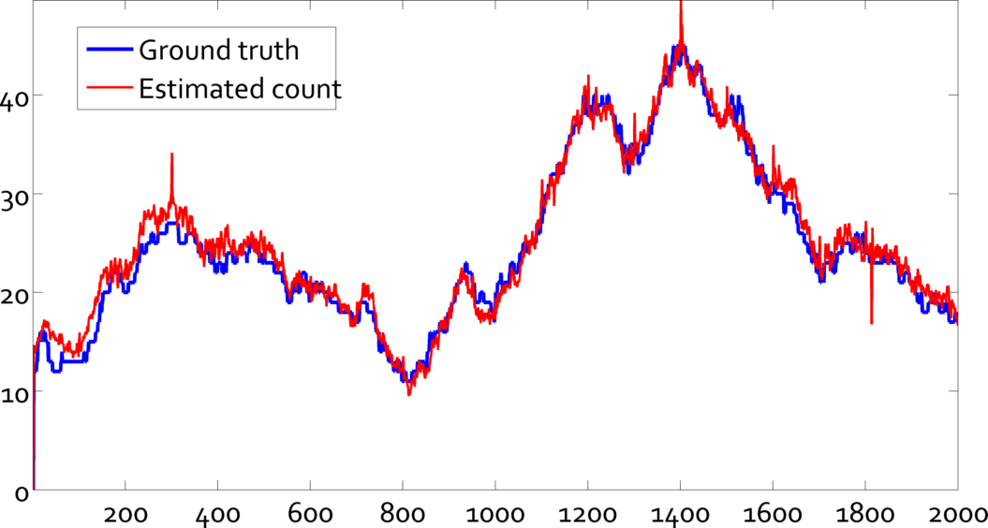
Number of people: estimated vs. GT
Training part
Spurious estimates may be fixed via median filtration.

Slide 33
Results demo
Count estimated by our method (trained on frames 1200-1600)
Ground truth count
click to play

Slide 34
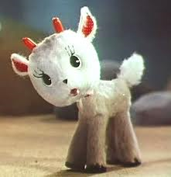
Summary
New framework for “learning to count”:
Simple (arguably): just solve a convex quadratic program
Uses minimalistic annotation
Can be trained on few images
Accurate
Very fast at runtime
Fast at training time
Flexible
may use any domain-specific features
may use output of other methods e.g. detector as features
TODO: extending to differentiated counts

Slide 35
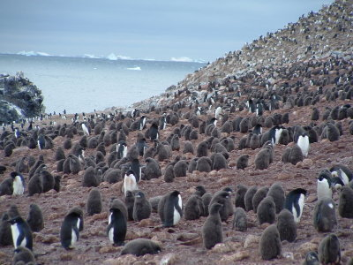
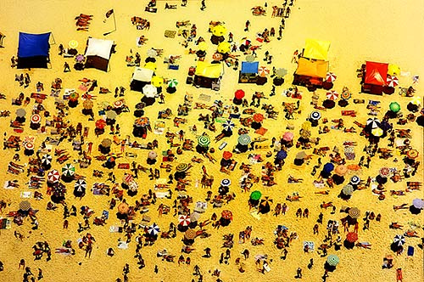
Target application
Our target application (still awaiting data):
Looking for other applications (please, contact us!)

