Slide 1
Minimal Problems in Google
Changchang Wu
Google

Slide 2
My Experience with Minimal Solvers
Pre-Google
VisualSFM (implemented a few)
Google products
Lens Blur, Photo Tours, Cardboard Camera (coded and used quite a few)
Recent work
P3.5P, Structure-less resection (made two new solvers for SfM)

Slide 3
3D Computer Vision in Google Products
Camera
Video capture
Lens Blur
Photo Sphere
Maps
Street View
Earth
Photo Tours
Cardboard Camera
Youtube
Photos

Slide 4
Minimal Problems in Google Products
6Dof Motion problem
Photo Tours
Lens Blur
Constrained motion problem
Video stabilization
Photo Sphere
Indoor Street view
Problem -> Modeling -> Solver selection
Notes:
I am not gonna talk about the specific details of implementation. Instead I think the choice of minimal solver is a modeling problem, and it is interesting to see how these problem are modeling differently.

Slide 5
Google Maps - Photo tours

Slide 6
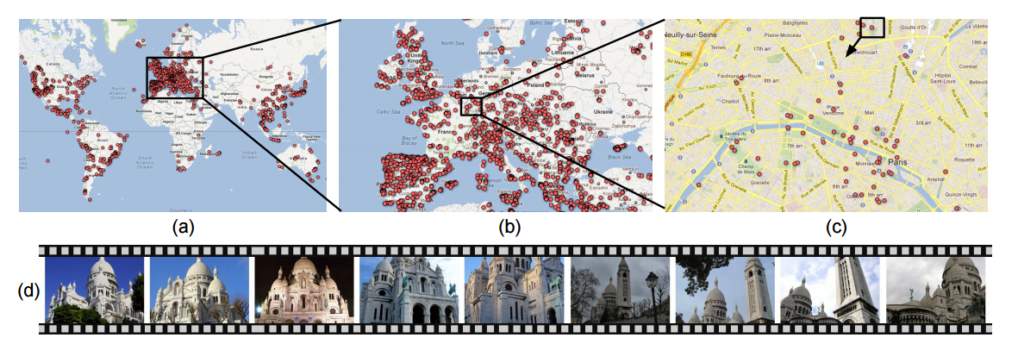
Google Maps - Photo tours
Imagery
Clustering
Structure
from Motion
Tour Computation
Image-based Rendering
Kushal et al. "Photo tours." 3DimPVT 2012

Slide 7
Photo Tours - Internet Photo SfM
The pose problem
Unconstrained motion between photos
Mixture of uncalibrated or approximately calibrated cameras
It is OK to have some failures
Use simple pinhole model for initial pose estimation
Using EXIF focal length when possible
Assuming principal point at image center
Ignoring radial distortion, skew, etc
5pt, 6pt & 7pt relative pose estimation (Initialization & Pairwise matching)
3pt & 4pt absolute pose estimation
Bundle adjustment (solve for radial distortion)

Slide 8
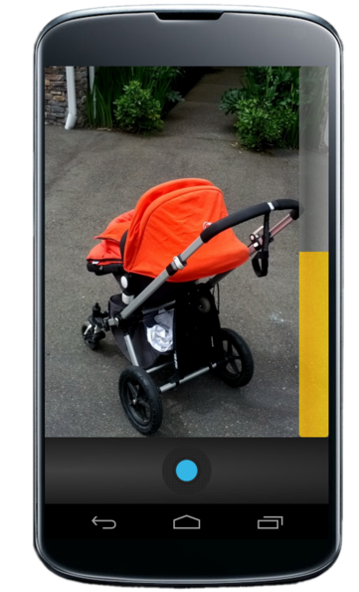
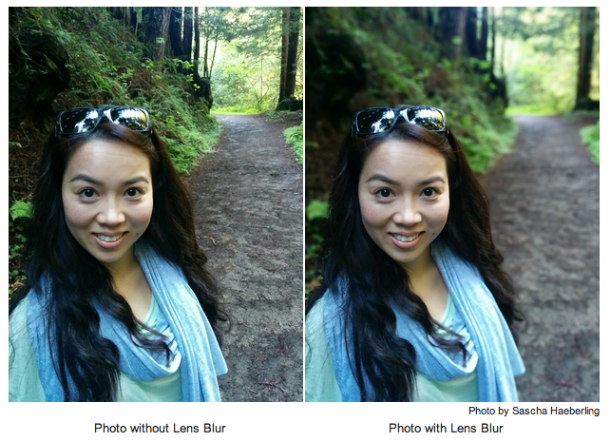
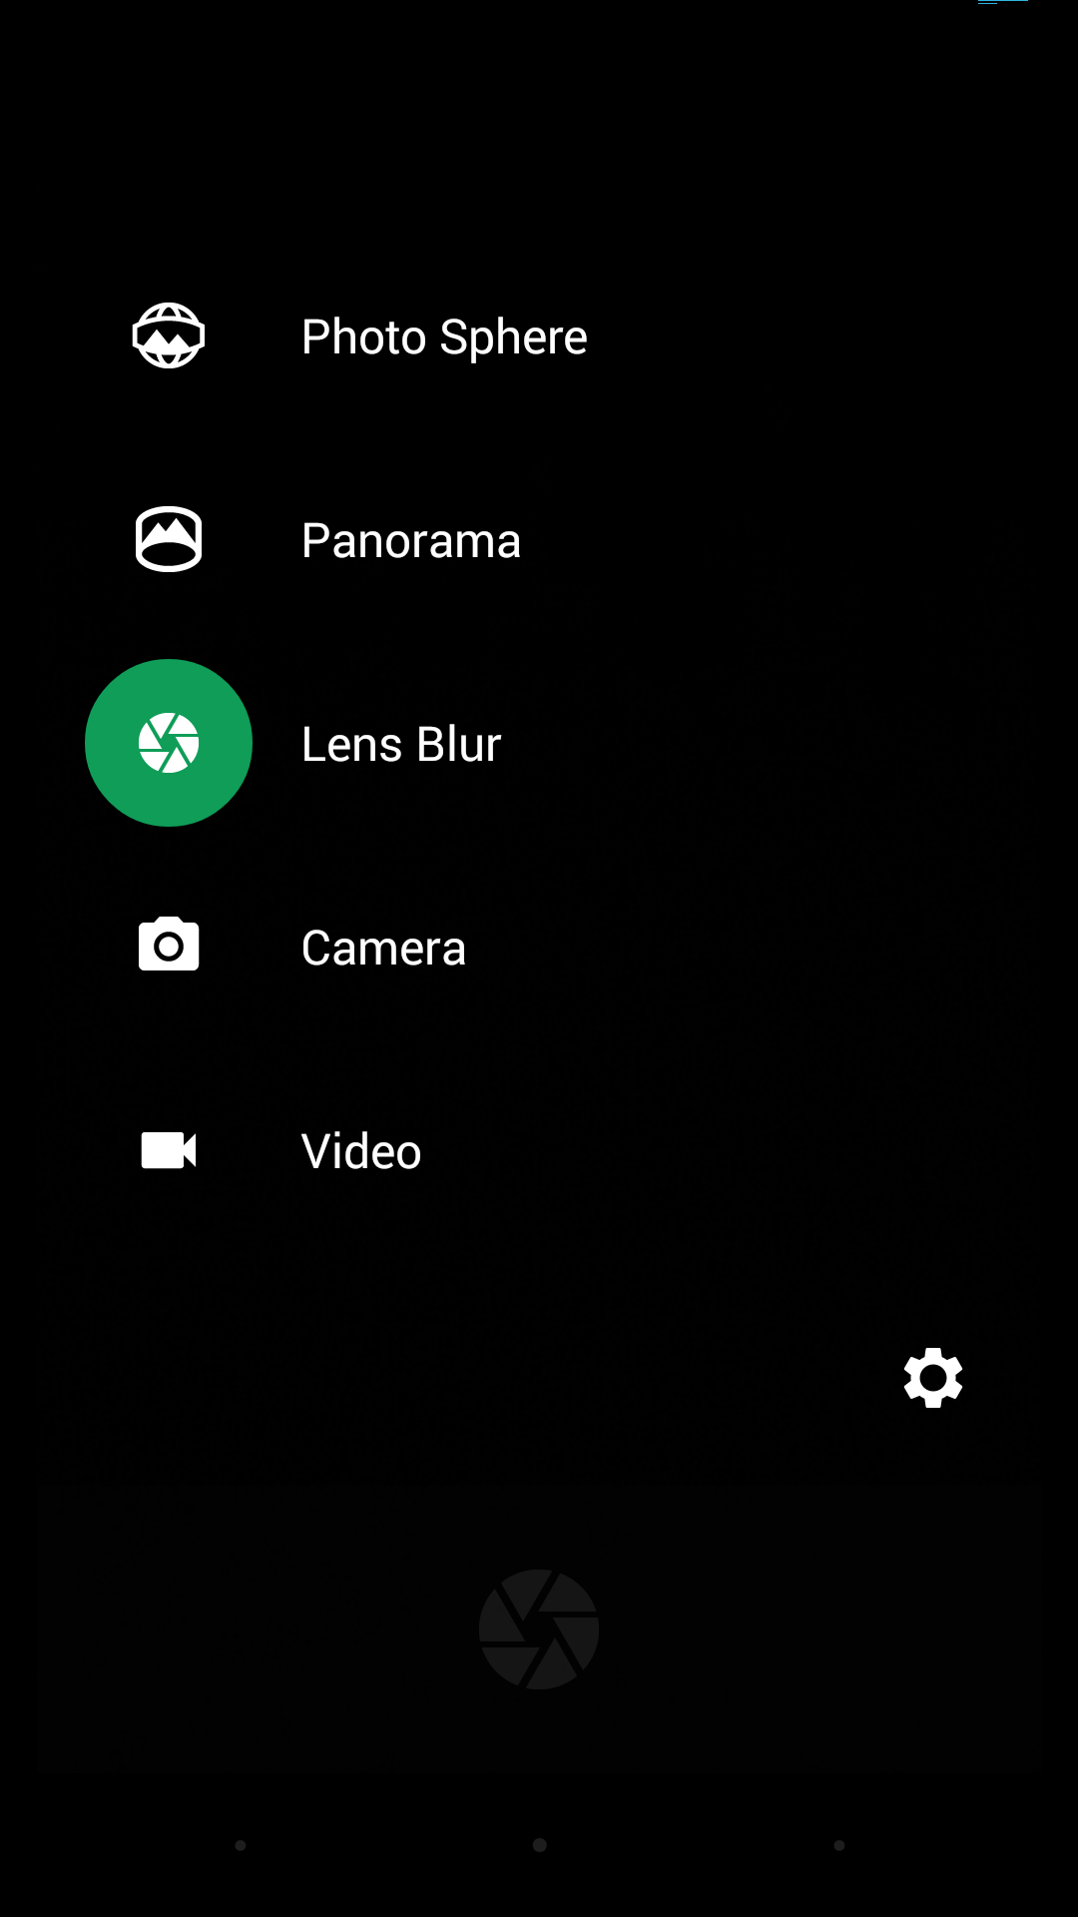
Google Camera - Lens Blur
Photo without Lens Blur Photo with Lens Blur
* Photo by Sascha Haeberling
* Slide courtesy of Carlos Hernandez

Slide 9
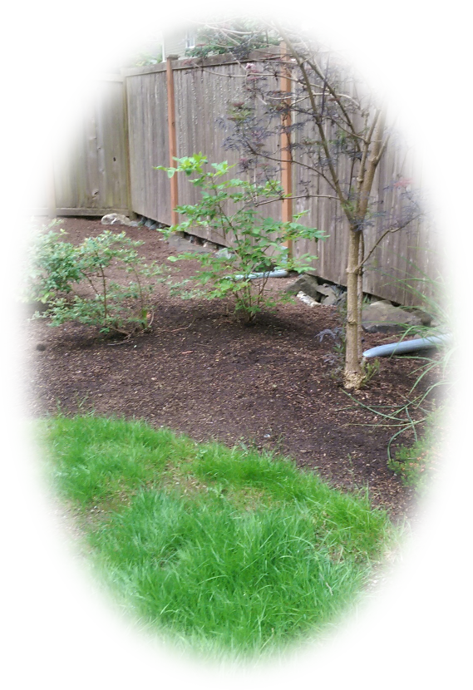
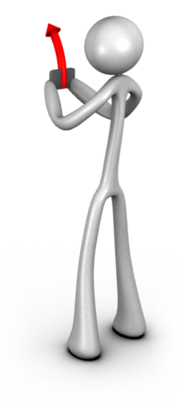
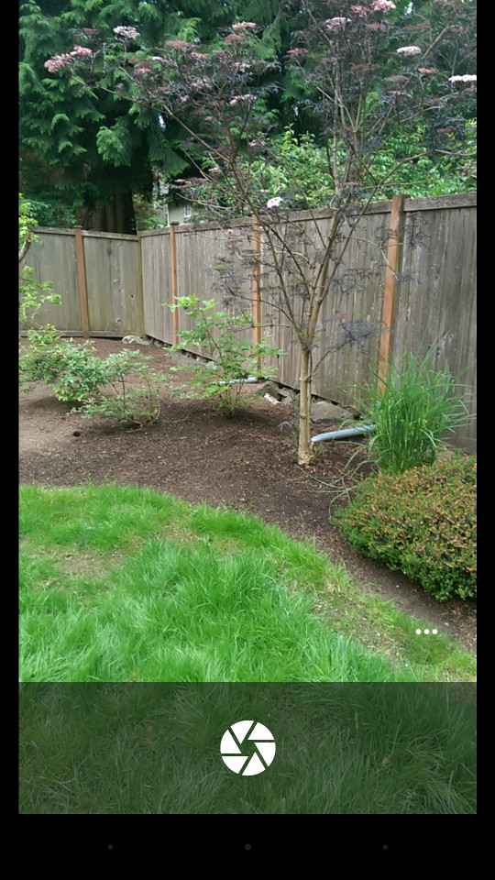
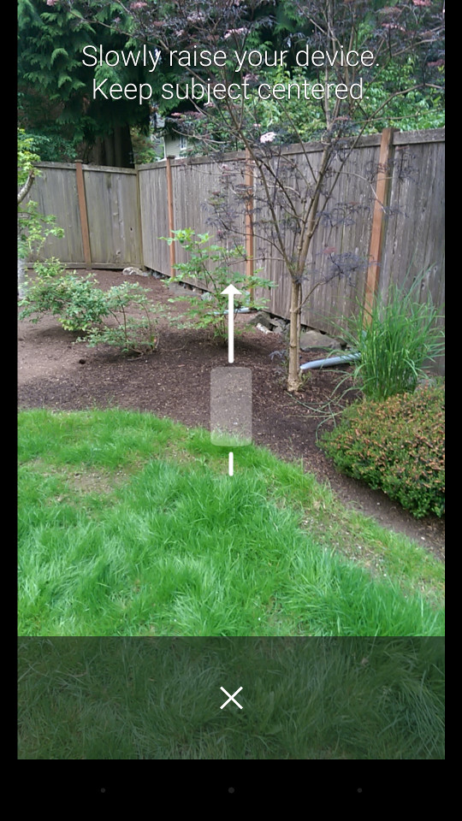
Lens Blur - Guided Capture
* Slide courtesy of Carlos Hernandez

Slide 10
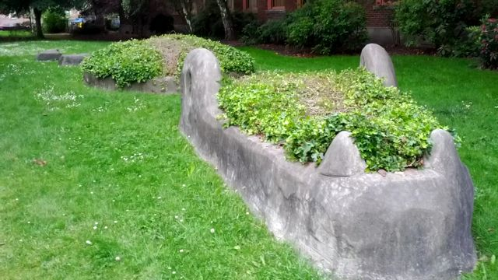
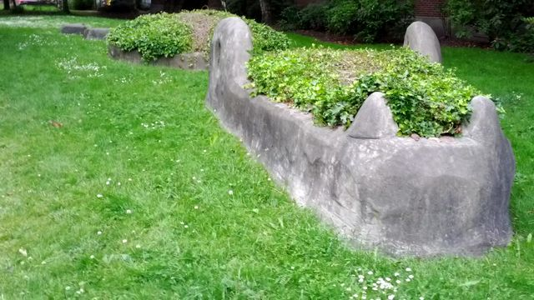
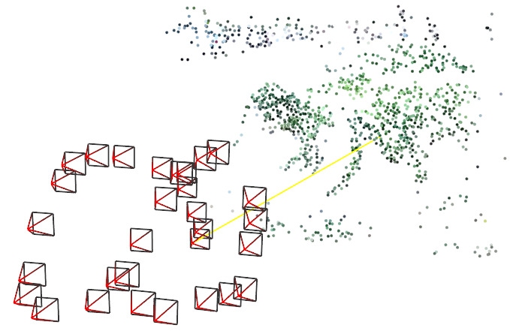
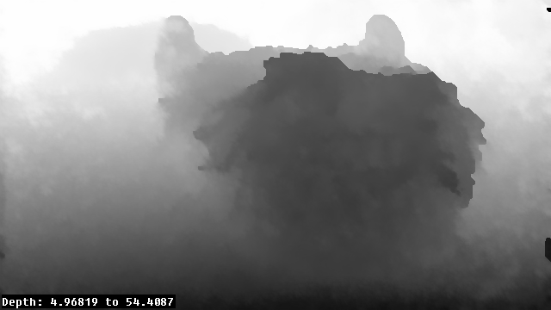
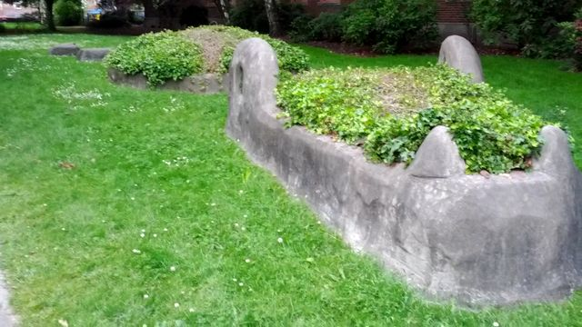
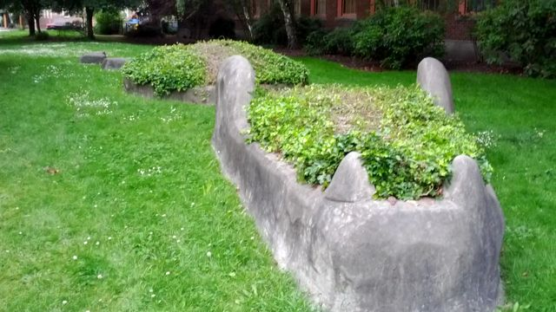
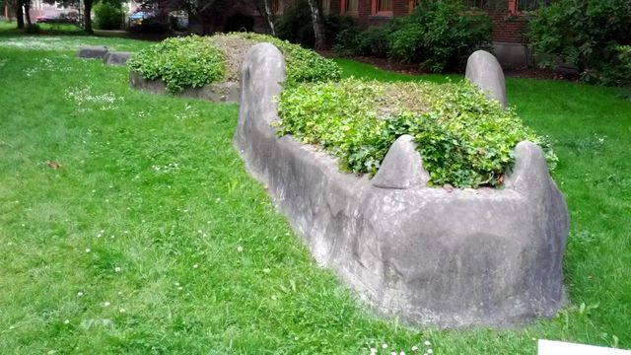
Lens Blur - Computer Vision Pipeline
Imagery
Acquisition
Structure
from Motion
Multi-View
Stereo
RGBZ
* Slide courtesy of Carlos Hernandez

Slide 11
Lens Blur - Structure from Motion
The pose problem
Small guided translation and rotation of a video sequence
Approximately camera calibration
Blurring effect not sensitive to small intrinsics errors
Two view initialization
5pt relative pose
Resection
3pt absolute pose
Bundle adjustment
* Slide courtesy of Carlos Hernandez

Slide 12
Minimal Problems in Google Products
6DoF motion problem
Photo Tours
Lens Blur
Constrained motion problem
Video Stabilization - Homography
Photo Sphere - Rotation
Indoor Street view - 3DoF motion

Slide 13
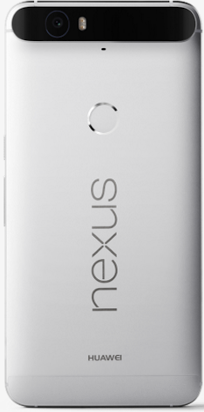
Google Camera - Video Capture with Stabilization
Real-time vision-based stabilization
Nexus 6P
Notes:
One big problem for video capture is stabilization. A handheld video can be very jittering to watch. Some manufacturers used a physical device on the camera to stabilize the optics according to gyro, which is called OIS. This year Google just announced two Nexus phones. For the bigger one Nexus 6P, instead of optical image stabilization, google used computer vision to produce real-time video stabilization. Let me switch to two comparison videos. As you can see, the right video with real-time stabilization is a lot more comfortable to watch.

Slide 14
Video Stabilization in Google Camera
The pose problem
Small translation and rotation between neighbouring frames
Approximately camera calibration & gyro
Want homography output for fast image warping
4pt Homography Estimation
Homography Stabilization
frame n
Feature Matching
5pt Relative Pose Estimation
Fusion with Gyro Data
frame n-1
* Slide courtesy of Chia-Kai Liang
Notes:
Basically we want to keep track of the motion between neighboring frames. Such relative motions are usually of small translation and small rotation. We have approximate camera calibration and gyro information. Something to be noted is that gyro is not always that great on mobile, and it can drift a lot with the exception of having very good gravity vector. Something specific for video stabilization is that we want to produce homography output for fast image warping. On the other hand, we can extract some rotation information by using 5pt relative pose estimation and gyro rotation, these information can help evaluating the quality of homography estimation, and help the stabilization. One thing to be noted is that these computation is quite expensive, so the feature is only avaiable on 6P.

Slide 15
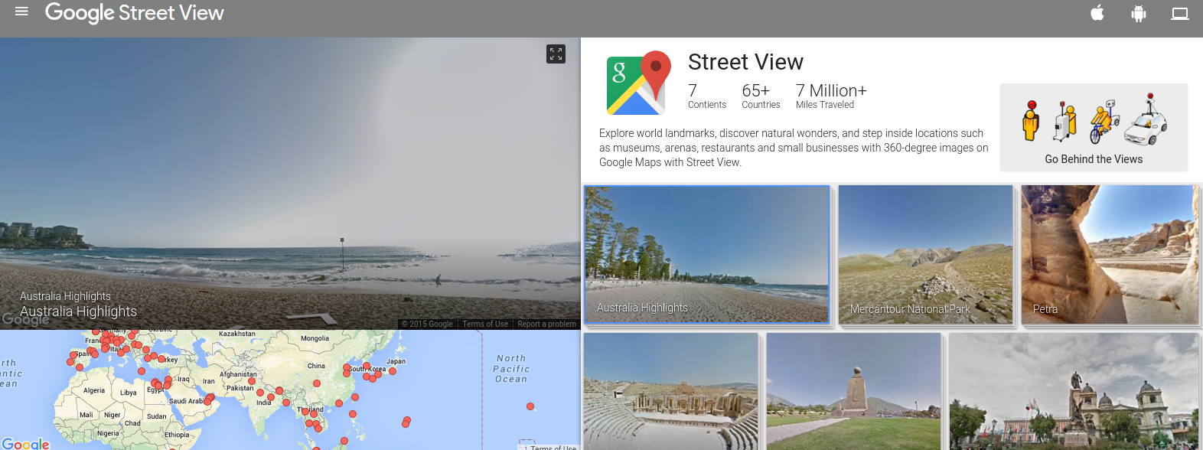
Google Camera - PhotoSphere
Notes:
Another nice feature of Google camera is PhotoSphere. Unlike most other panorama capture app that only capture the camera vertical FOV, It allows to capture the entire sphere like the streetview car. User can also publish their own photospheres to streetview, which allows it to cover more places and make streetview more useful.

Slide 16
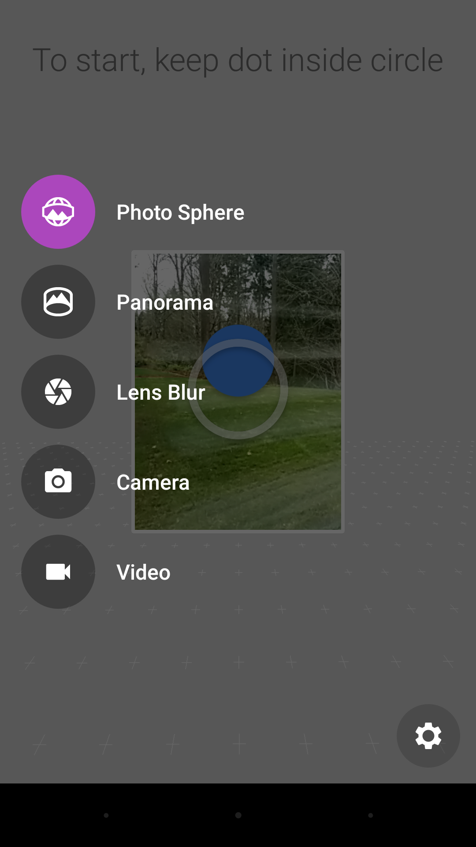
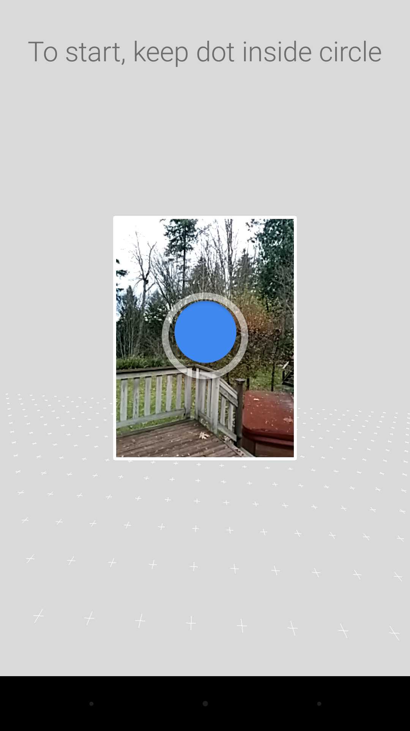
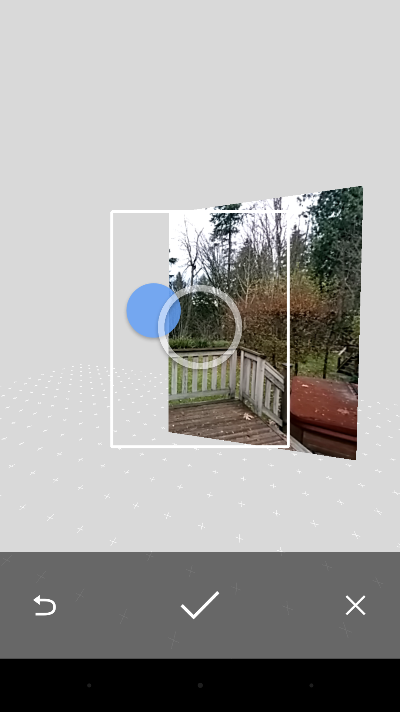
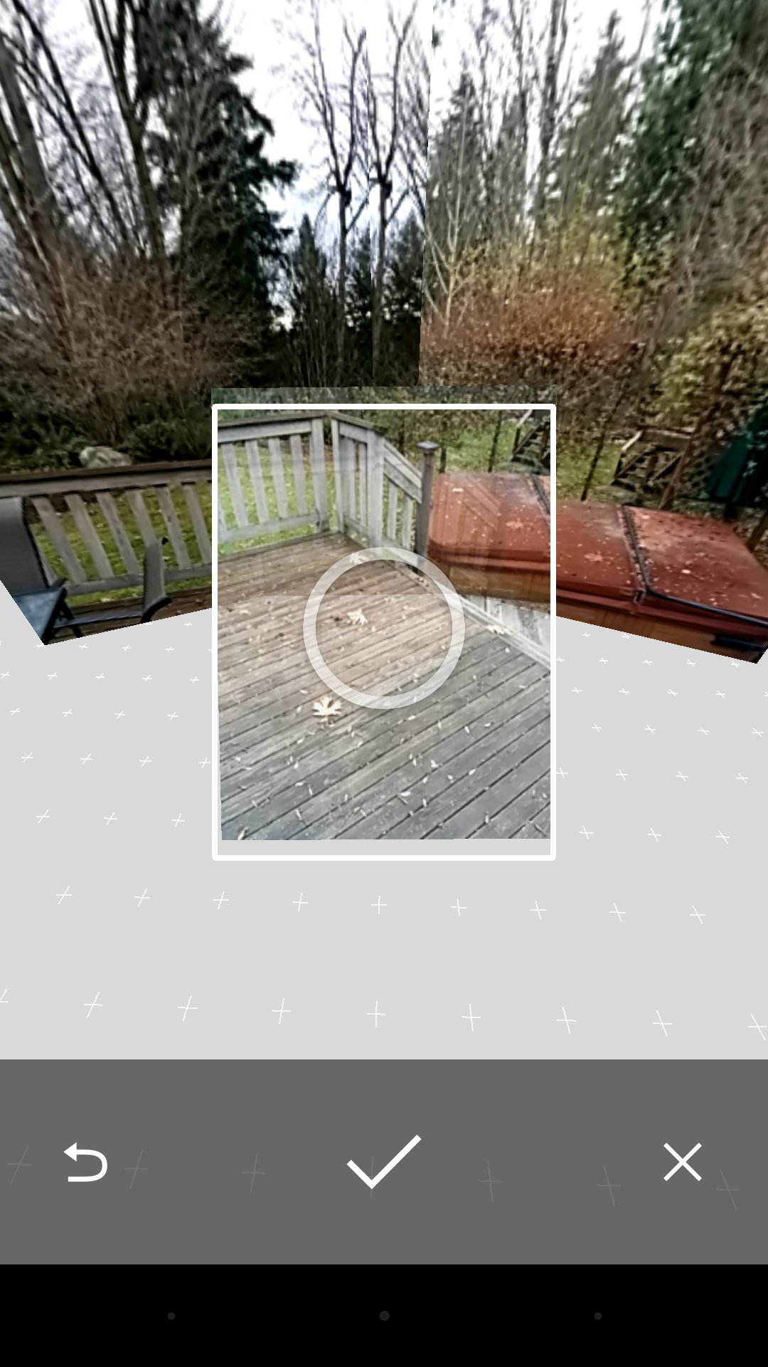
PhotoSphere - Guided Capture

Slide 17
PhotoSphere - Rotation Estimation
The pose problem
Small translation during the capture
Large rotation changes (360)
Approximately camera calibration & gyro
We only care about the rotation output
Camera calibration
Some phones do not report their focal length correctly
Some phones has relatively large lens distortion
Self-calibration is unreliable due to small translation
Gyro
We have quite accurate gravity vector & tilt
There can be large drift of yaw and roll
* courtesy of David Lee

Slide 18
PhotoSphere - Rotation Estimation
The pose problem
Small translation during the capture
Large rotation changes (360)
Approximately camera calibration & gyro
During capture
Post-capture processing
1pt Real-time Yaw Estimation
Gyro-drift correction
2pt 3D Rotation Estimation
Stitching
Rotation-only estimation is more robust to calibration errors than other higher-DOF solvers (e.g. relative pose)
* courtesy of David Lee

Slide 19
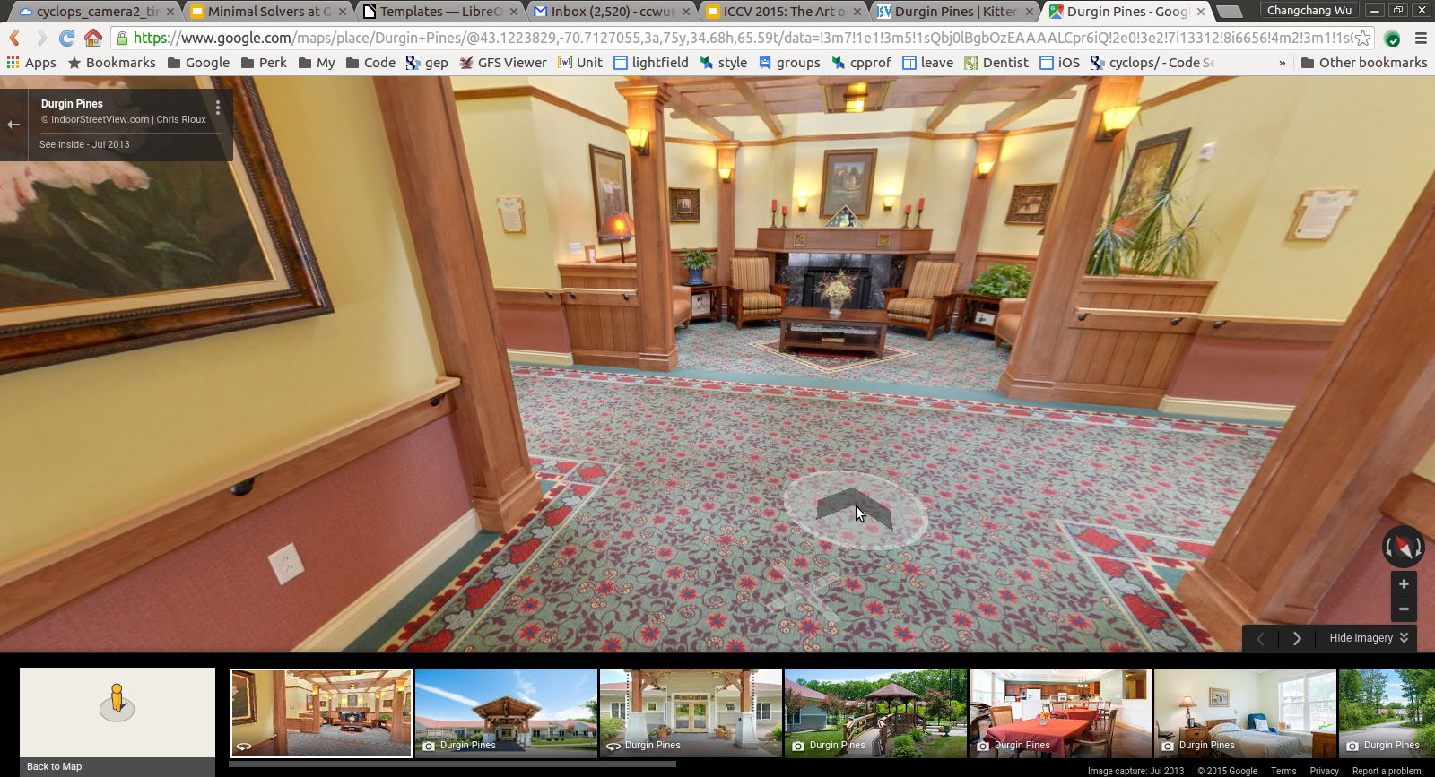
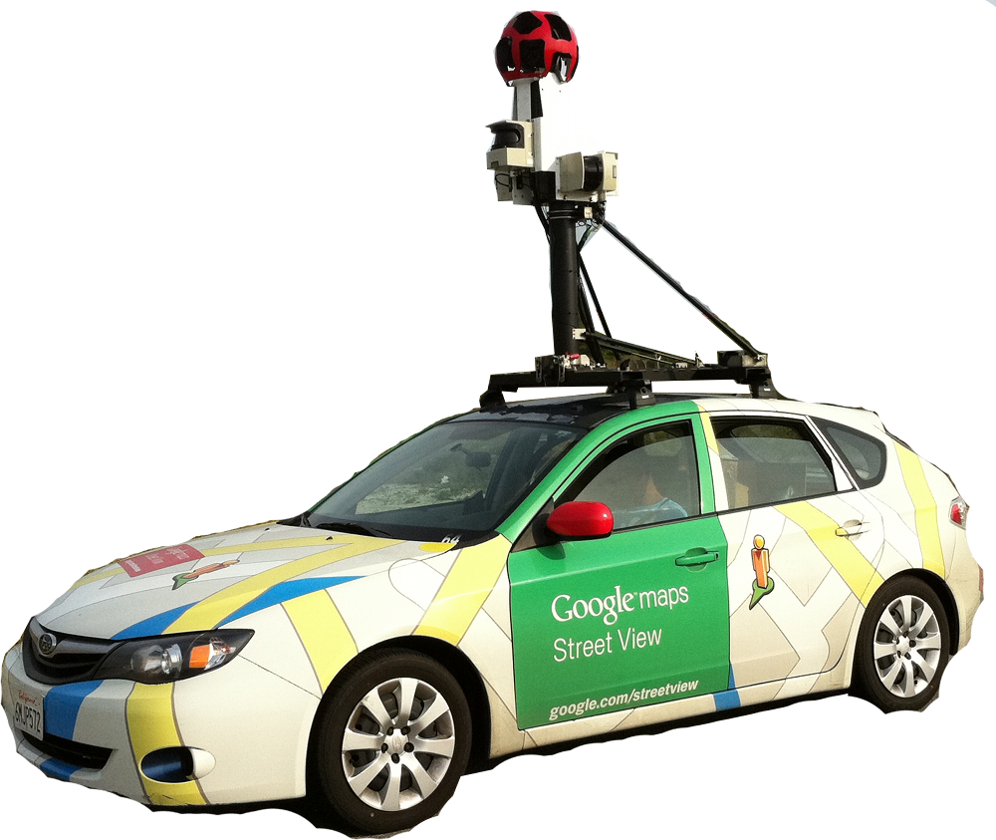
Indoor Street View
Street View inside Businesses
* Slide courtesy of Scott Satkin
Notes:
Now, Indoor streetview. It is another nice part of google streetview. It is served on google maps and provides indoor panorama. It is a really useful feature for both customer and business owners, as it allows user to see how a business looks like inside.

Slide 20
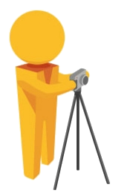
Indoor Street View - Capture
Street View Trusted Photographer
No other sensors to keep track relative pano poses besides camera pixels
* Slide courtesy of Scott Satkin
Notes:
Google will send trusted photographers to take panoramas with some spacing inside the business. Each panorama is well calibrated and stitched, but there is not other senses or … It is generally pretty hard for indoor, but we want to extract as much information as possible from pixels.

Slide 21
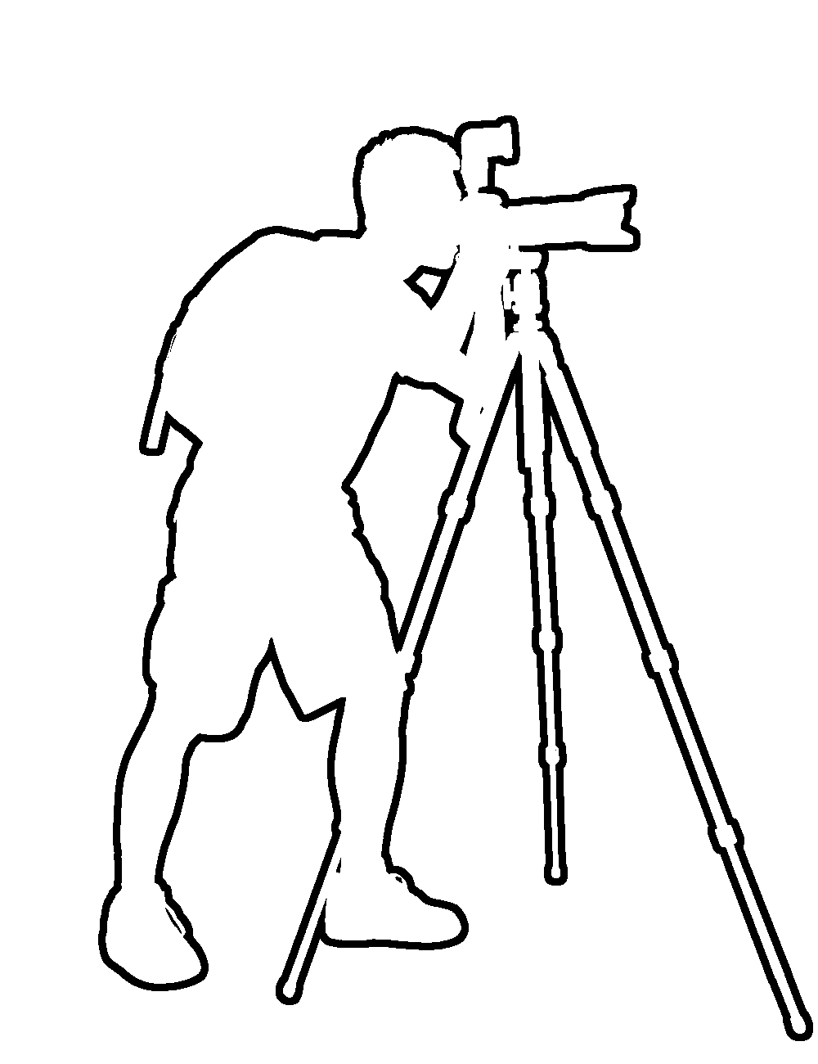
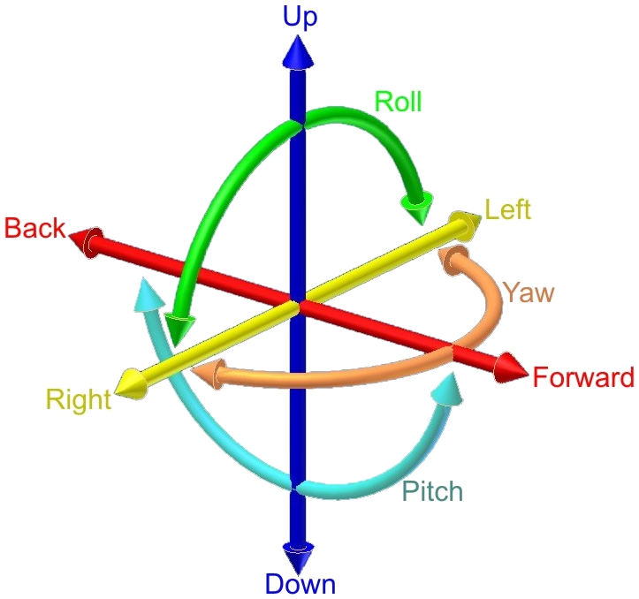
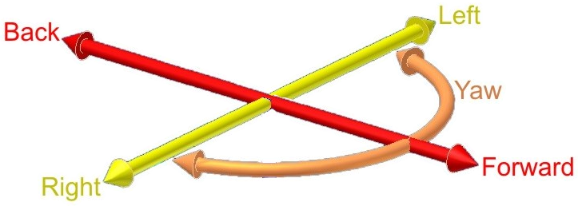
Indoor Street View
The pose problem
Relative pose between panoramas
Panoramas are by controlled capture on level surfaces
6 DoF
3 DoF
* Slide courtesy of Scott Satkin

Slide 22
Efficient 2-Point Solver (up to scale)
6 DoF motion
(5 pairs of correspondences)
3 DoF motion
(2 pairs of correspondences)
* Slide courtesy of Scott Satkin

Slide 23
Exploit Priors As Much As Possible
Pick a compact model to start with
Approximate calibrations are often good enough for initial estimation
Fewer parameters -> less ambiguity & faster
Let non-linear optimization deal with hard parameters
Do in-RANSAC solution filtering in RANSAC
Some priors are hard to encode in the minimal solvers
For example, positive focal length, and positive depth, gyro rotation
Let there be priors
Guided and controlled capture
Some parameters may not matter much for final output

Slide 24
My Development Experience
Make code run on both desktop/cloud and mobile
Lens Blur & Photo tours & Video Stabilization
Use Eigen3 (SIMD available for both)
Testing on desktop
Completeness is important
Any possible corner case can happen
e.g. solving for cos(x) can get >1, focal length can epsilon
Write good RANSACs
This is what users work with

Slide 25
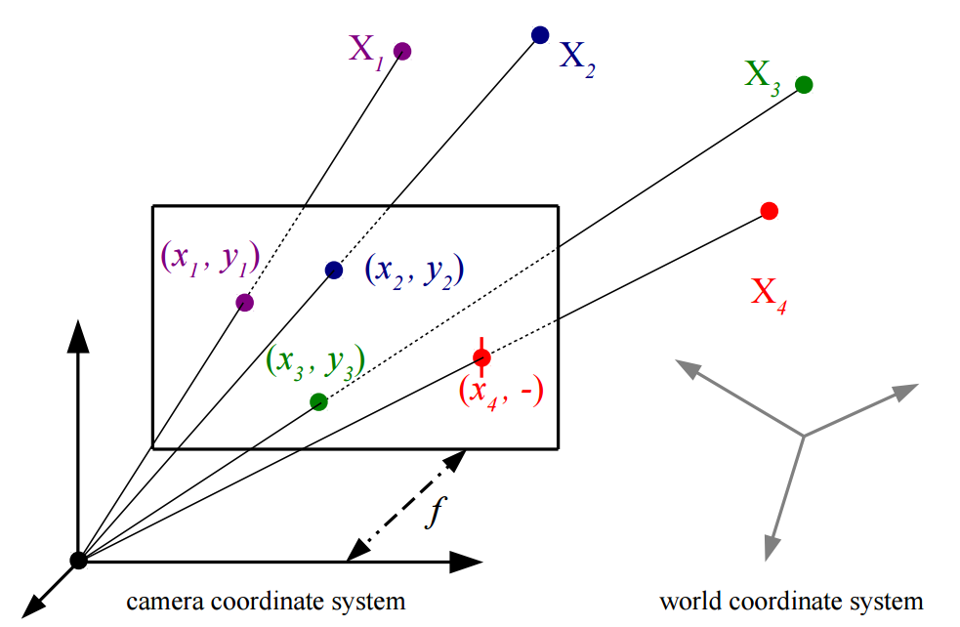
P3.5P: Pose Estimation With Unknown f (C. Wu, CVPR 2015)
Truly minimal & General
Exactly 7 constraints
P4P -> P3.5P
A new parameterization
See the trick session
Simpler polynomials
Degree 7 (Zheng) -> 6
GB 36x53 (Zheng) -> 20x30

Slide 26
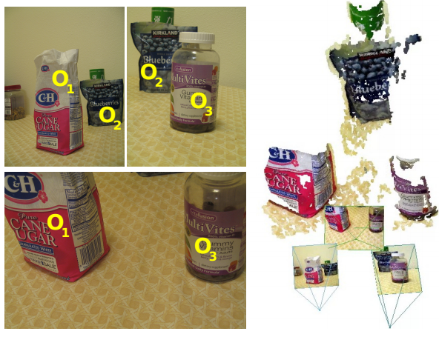
Structure-less Resection (E. Zheng, C. Wu, ICCV 2015)
Resection using 2D correspondences among pinhole cameras
6pt solver for the calibration problem
7pt solver for the uncalibrated problem

Slide 27
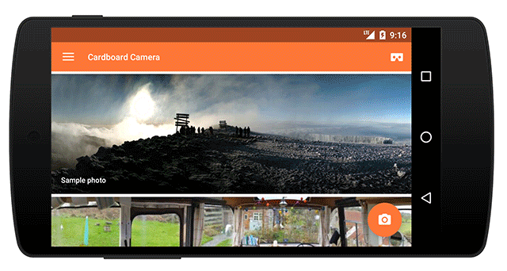
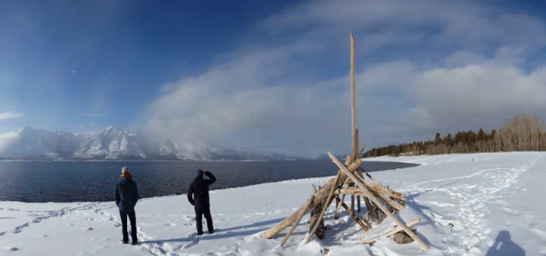
Cardboard Camera App!
Take your own VR Photos - 3D panorama with sound!

Slide 28
Thank you!

