Slide 1
Solving Minimal Problems
Numerics
Kalle Åström, Centre for Mathematical Sciences,
Lund University, Sweden

Slide 2
Solving System of Polynomial Equations
Step by Step once more
System of equations
Expand by multiplying each equation with a number of monomials
Choose a set of Basis monomials
Choose an action variable, e g
Calculate monomials to reduce R and the rest E
Re-order monomials
Gaussian elimination

Slide 3
Solving System of Polynomial Equations
Step by Step once more
Gaussian elimination
Form Action matrix
Solve eigenvalue problem
Extract solutions from eigenvalues/eigenvectors
What is the main cause of bad numerics?

Slide 4
Solving System of Polynomial Equations
Step by Step once more
From Gaussian elimination
Form Action matrix
Solve eigenvalue problem
Extract solutions from eigenvalues/eigenvectors
What is the main cause of bad numerics?

Slide 5
Ways to improve numerics
Redo the problem formulation
  Simpler equations, fewer unknowns
Choice of polynomials to multiply with (expansion)
Choice of basis monomials
Numerical linear algebra (SVD, QR)
Exploit symmetry

Slide 6
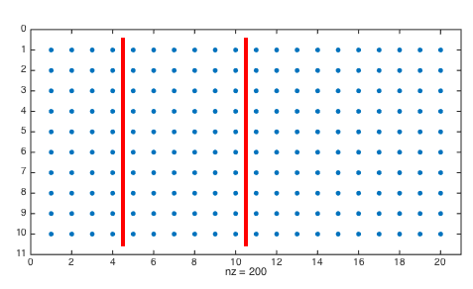
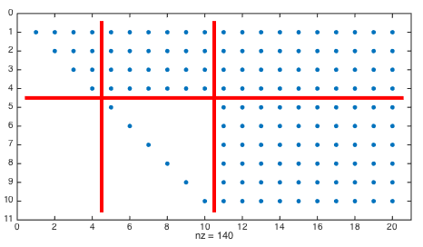

Slide 7
QR with column pivoting
- as a method for choosing basis monomials
Choose a set P of monomials (slightly larger than B, before)
Reduce E and R part as before
Use QR with column pivoting to choose basis monomials B among P that minimize the condition number

Slide 8
QR with column pivoting
(Byröd, Josephson, Åström, IJCV 2009)

Slide 9
SVD method
- as a method for choosing basis polynomials
Choose a set P of monomials (slightly larger than B, before)
Reduce E and R part as before
Use QR with column pivoting to choose basis monomials B among P that minimize the condition number
Theoretically better, but more complicated to code and longer time to compute. ☹

Slide 10
Optimizing (i) expansion and (ii) set of permissible monomials
Generate a small benchmark set of examples
Change the set of permissible monomials.
Evaluate on the benchmark set.
Perform local optimization.
Difficult optimization problem, many local minima.
Potential for improvement

Slide 11
Optimizing (i) expansion and (ii) set of permissible monomials
Generate a small benchmark set of examples
Change the set of permissible monomials.
Evaluate on the benchmark set.
Perform local optimization.
Difficult optimization problem, many local minima.
Potential for improvement

