Slide 1
Minimal Solvers, Structure and Motion, Sound and Radio
Kalle Åström, Centre for Mathematical Sciences,
Lund University, Sweden

Slide 2
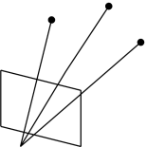
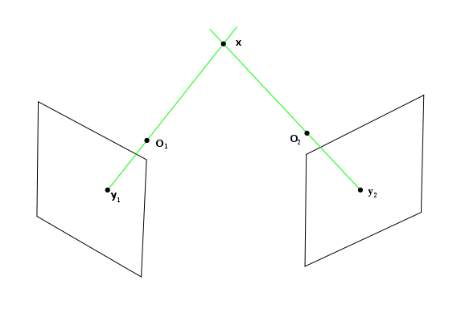
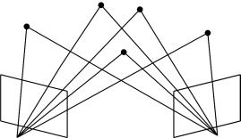
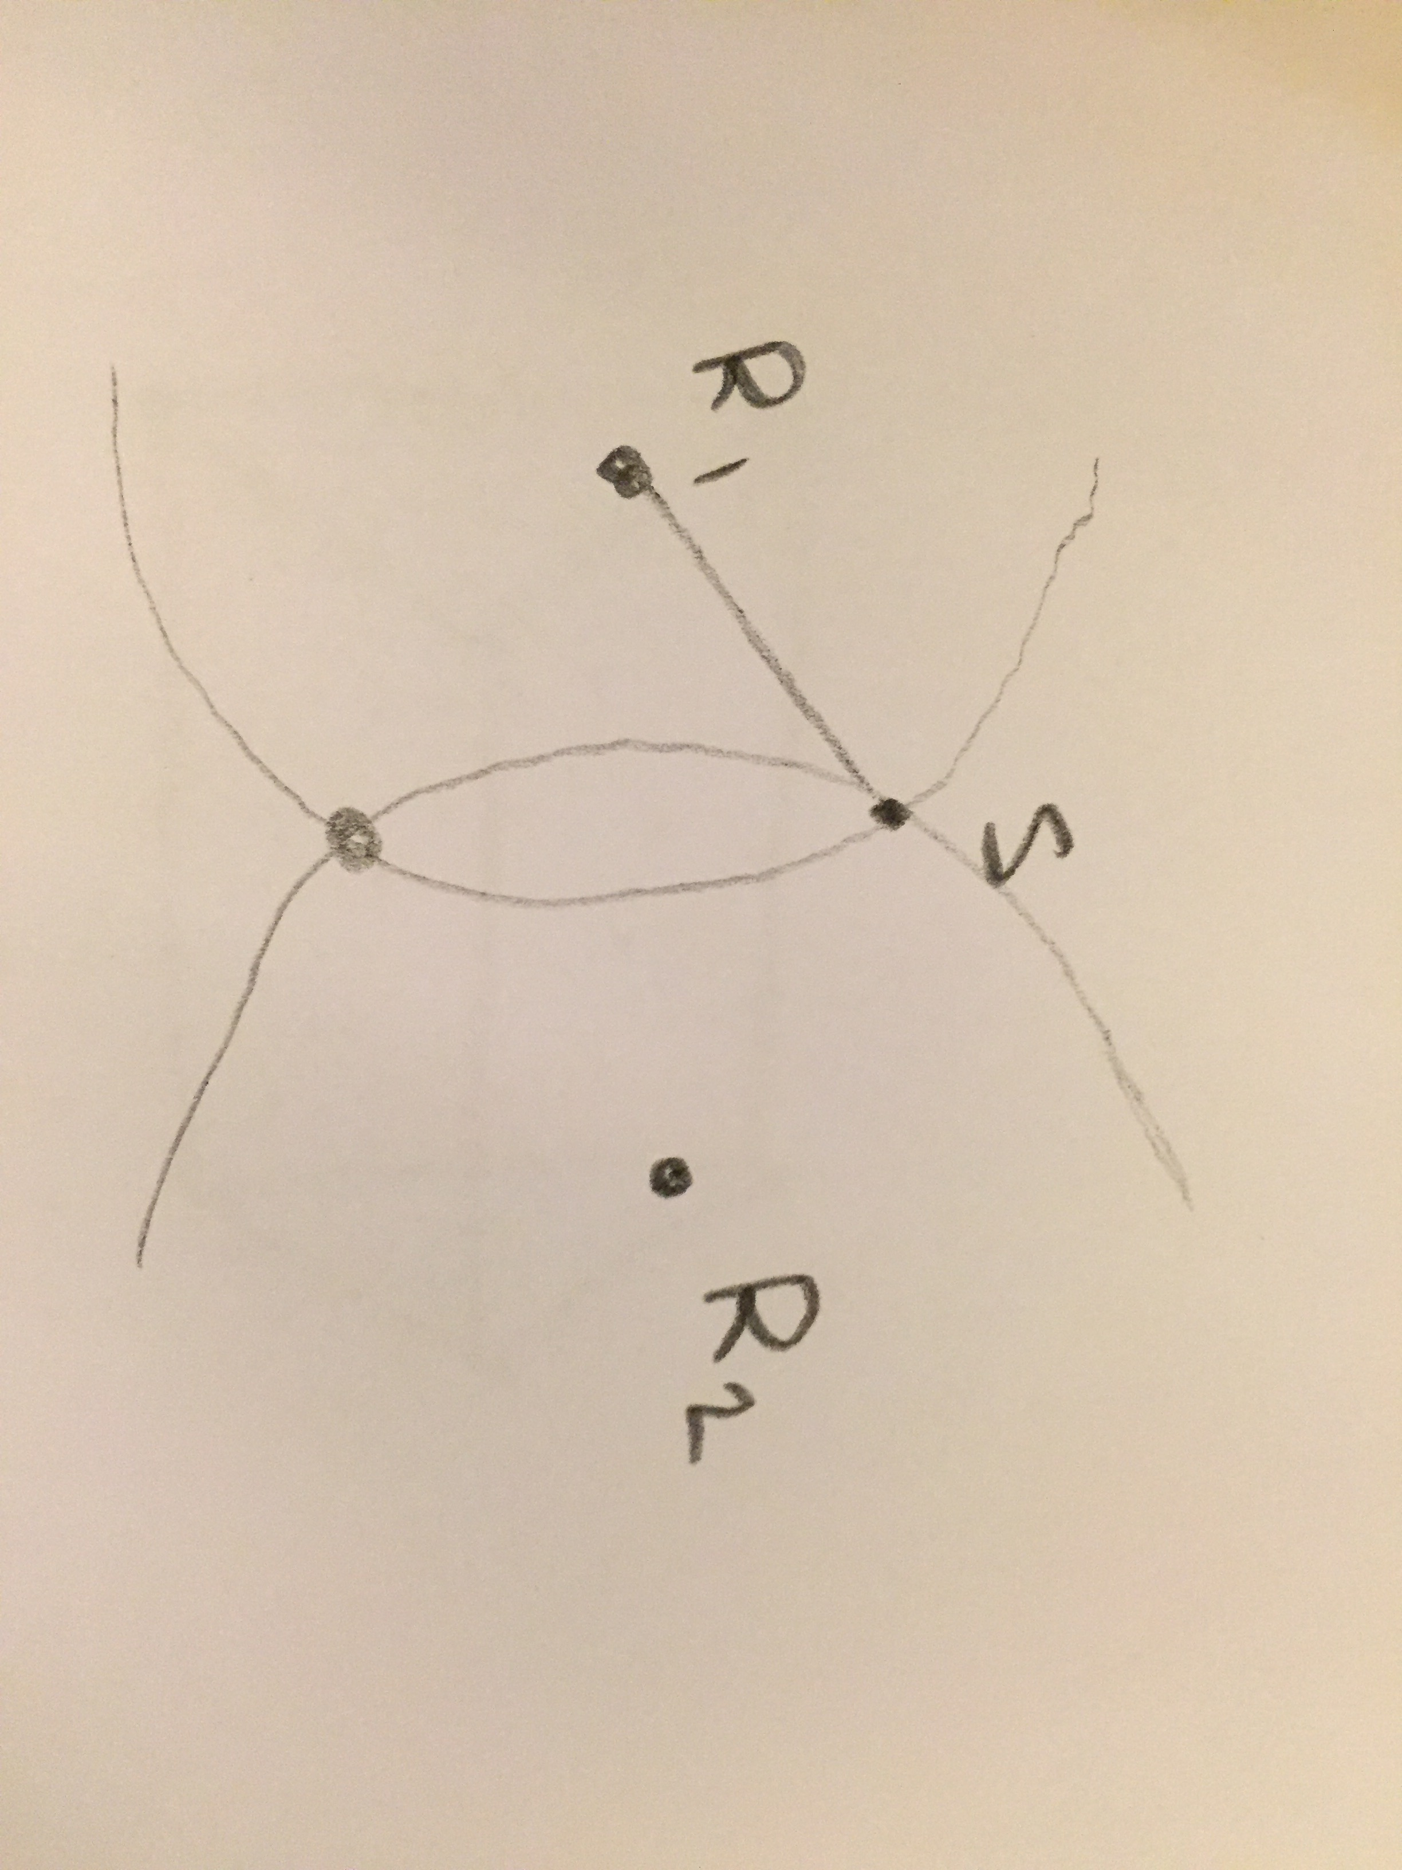
Minimal problems
Vision involve
  Directions
  Triangulation
  Pose
  Structure from motion
Other problems involve
  Distances
  Trilateration
  Structure from motion

Slide 3
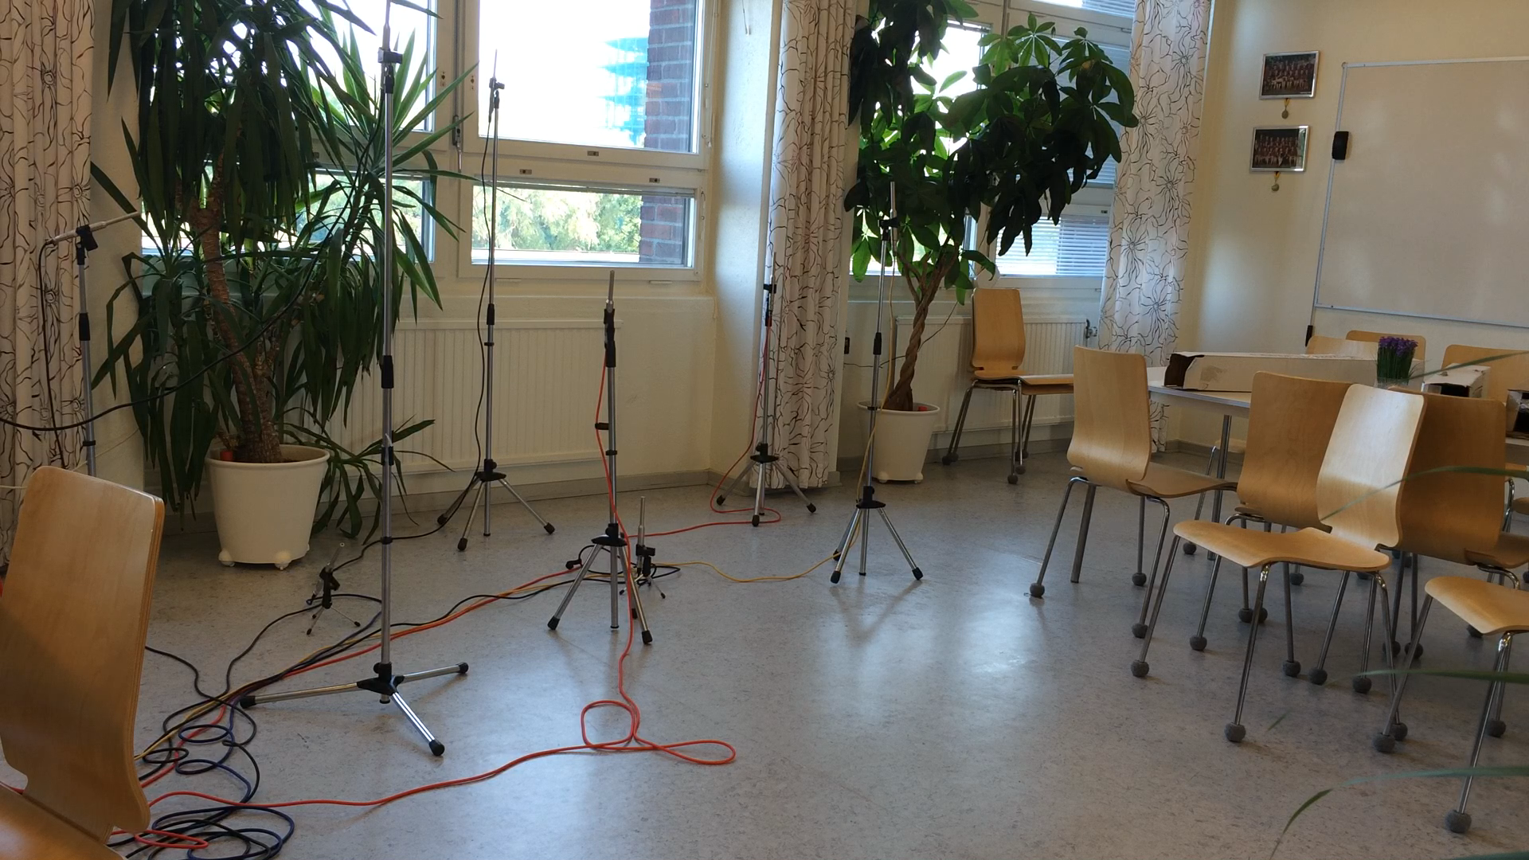
Structure and motion using sound
Z. Simayijiang et al, An Automatic System for Microphone Self-Localization Using Ambient Sound, EUSIPCO 2014.
S. Rex, Robust Time Difference Estimation for Unknown Microphone Positions with Reverberation, 2015.

Slide 4
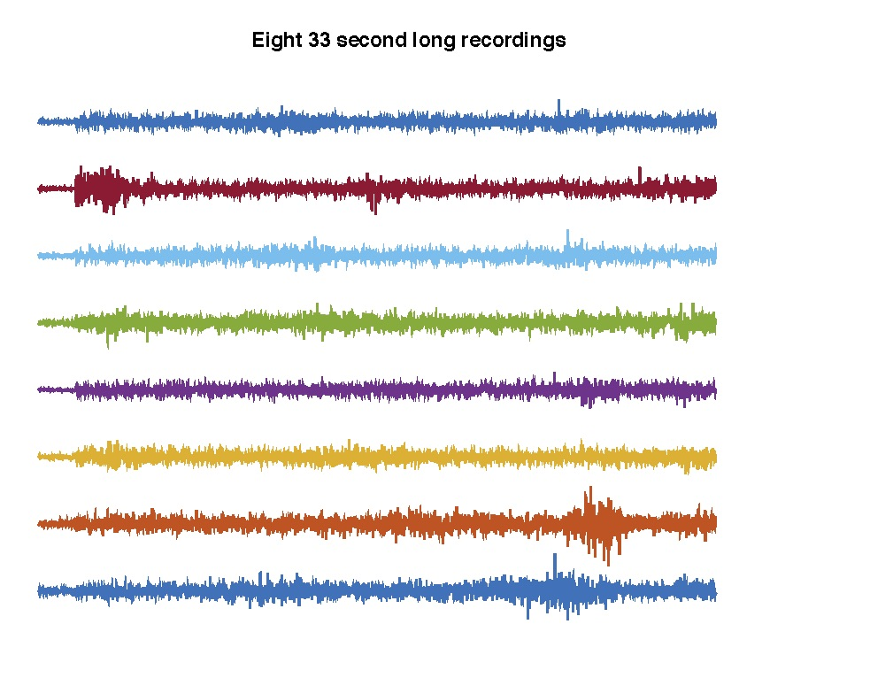
Can you hear the shape of the room?
Using only the audio files
Where are the microphones?
Where are the sound source(s)?
How do the sound sources move?
What is the shape of the room?
Map = microphones.
  Map-making = estimating microphone positions
Local positioning system relative to the map

Slide 5
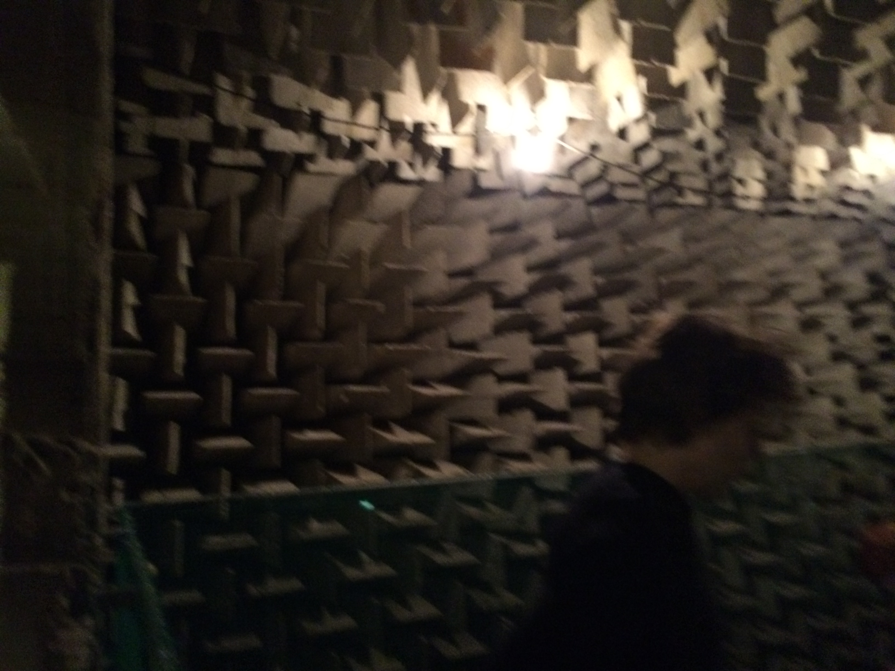
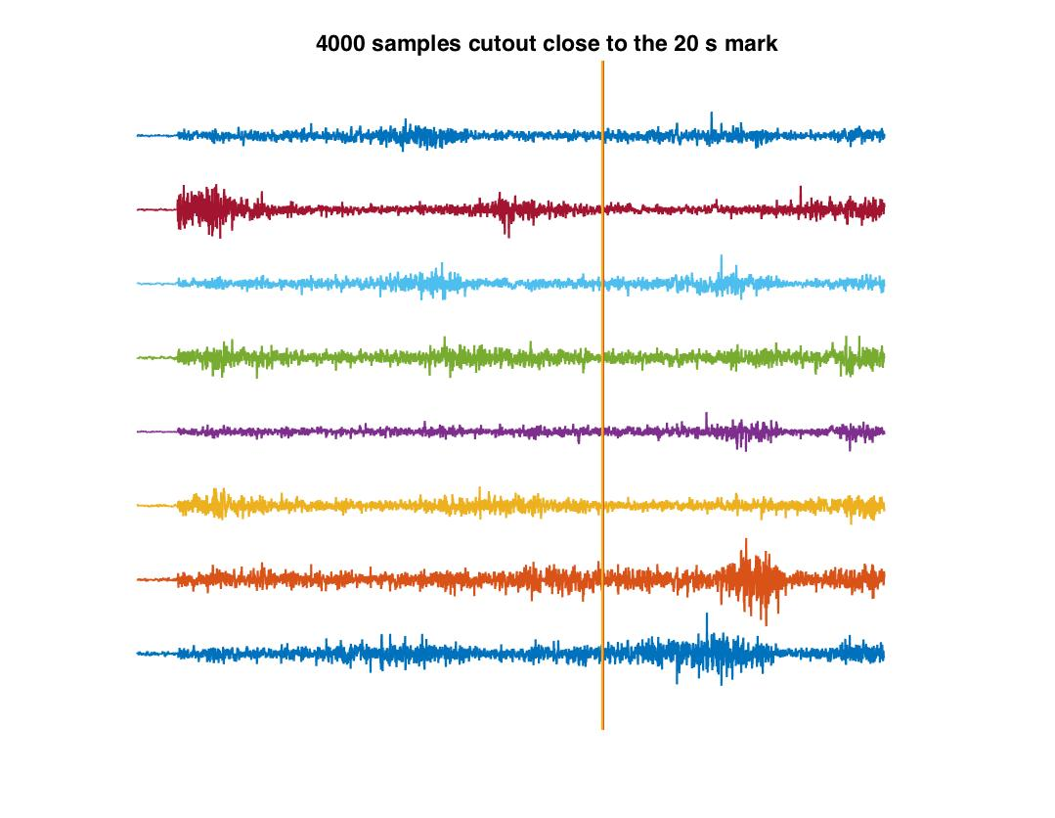
Cutout of 4000 samples at 20s/33s,
Example: anaechoic chamber
4000 samples
Approx 41 ms

Slide 6
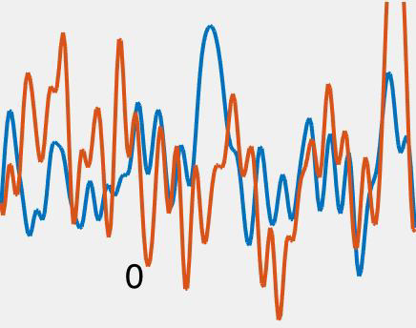
Plot of 200 samples from channels 1 vs 2
Shift one signal until it ’fits’ the other
96000 samples/s
340 m/s
199 samples corresponds to
(199*340)/96000 m
70 cm

Slide 7
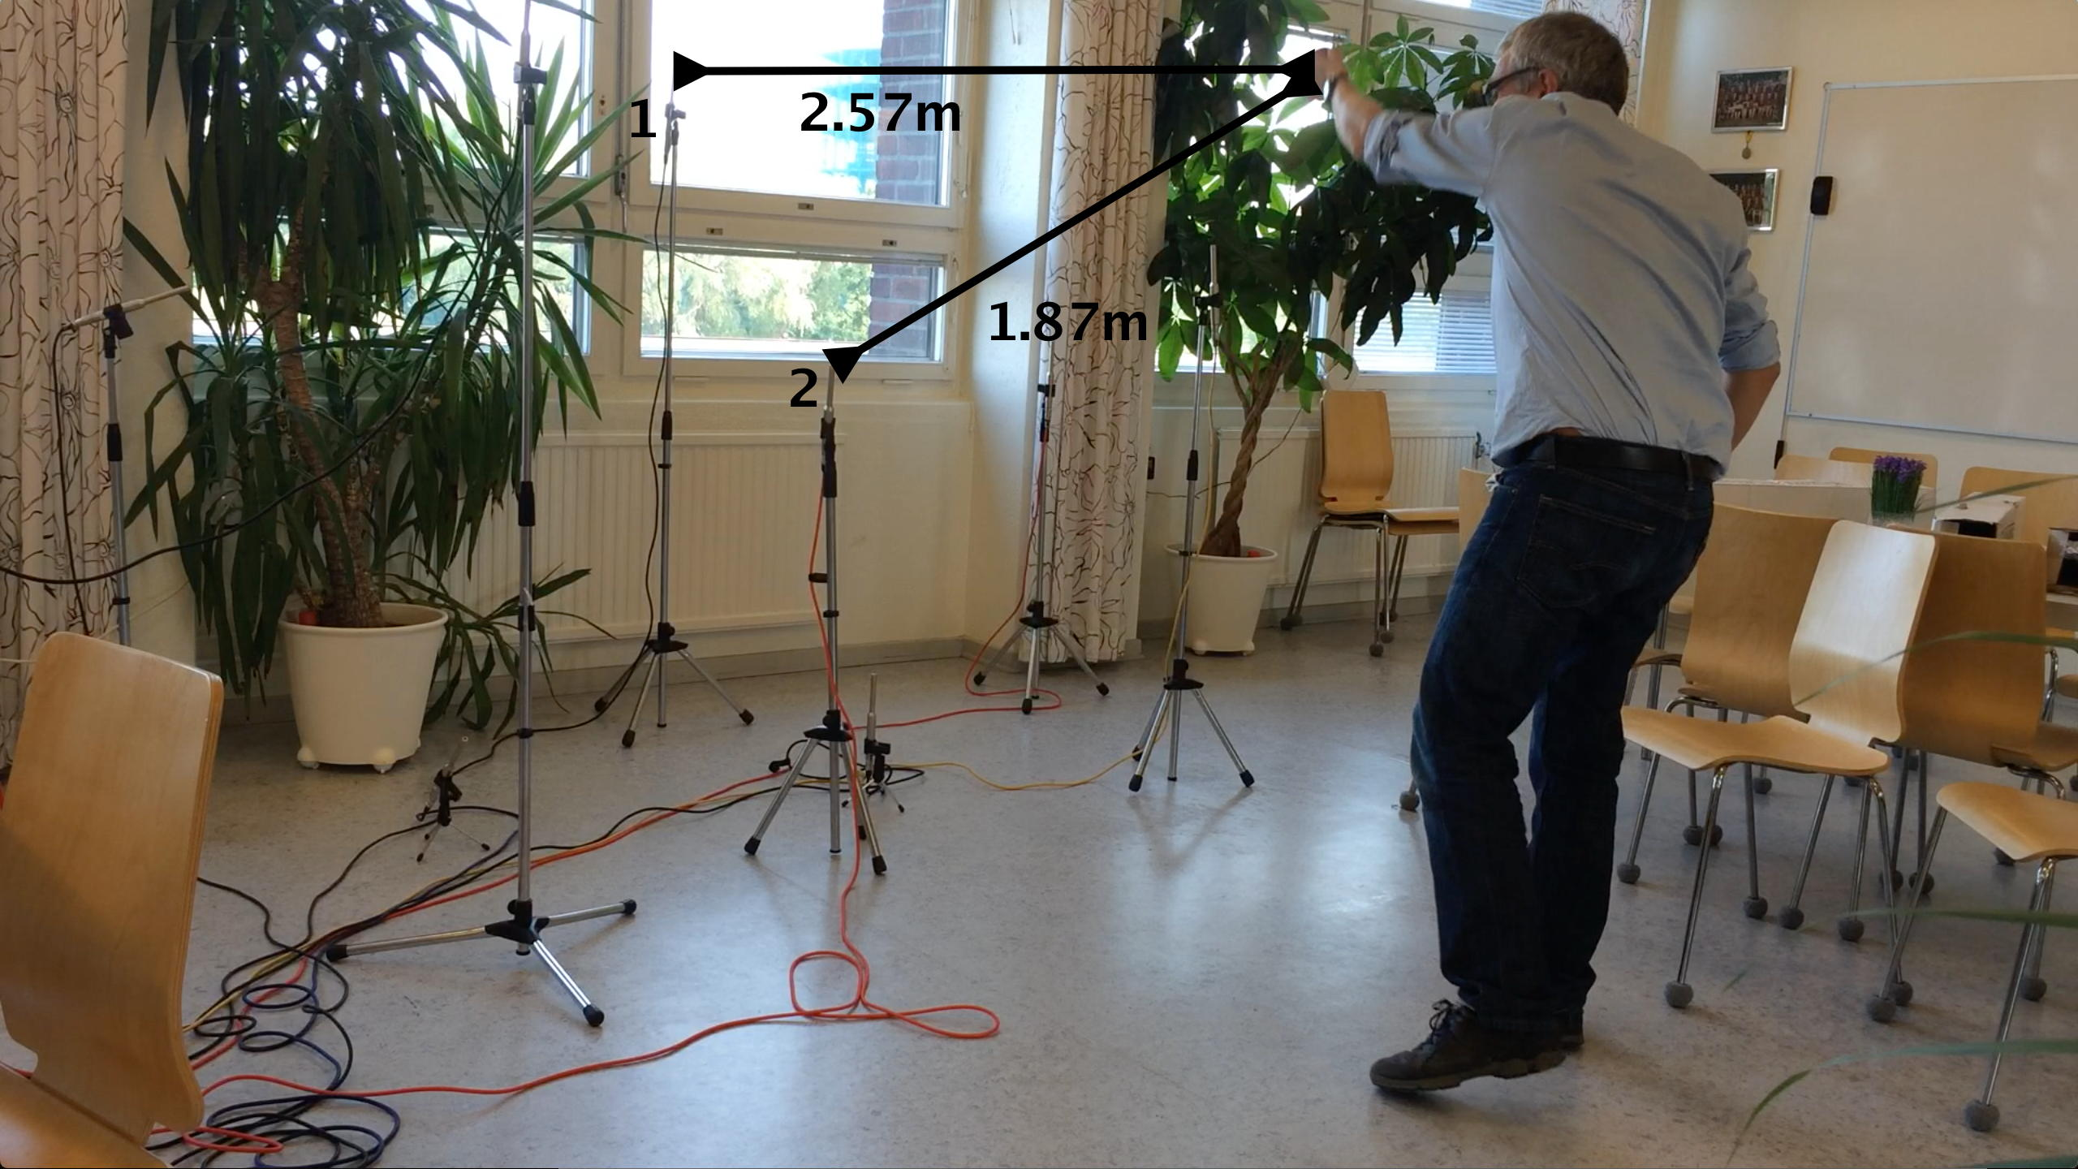
Displacement of channels corresponds to distance differences, ex 1.87m – 2.57m = -0.7m

Slide 8
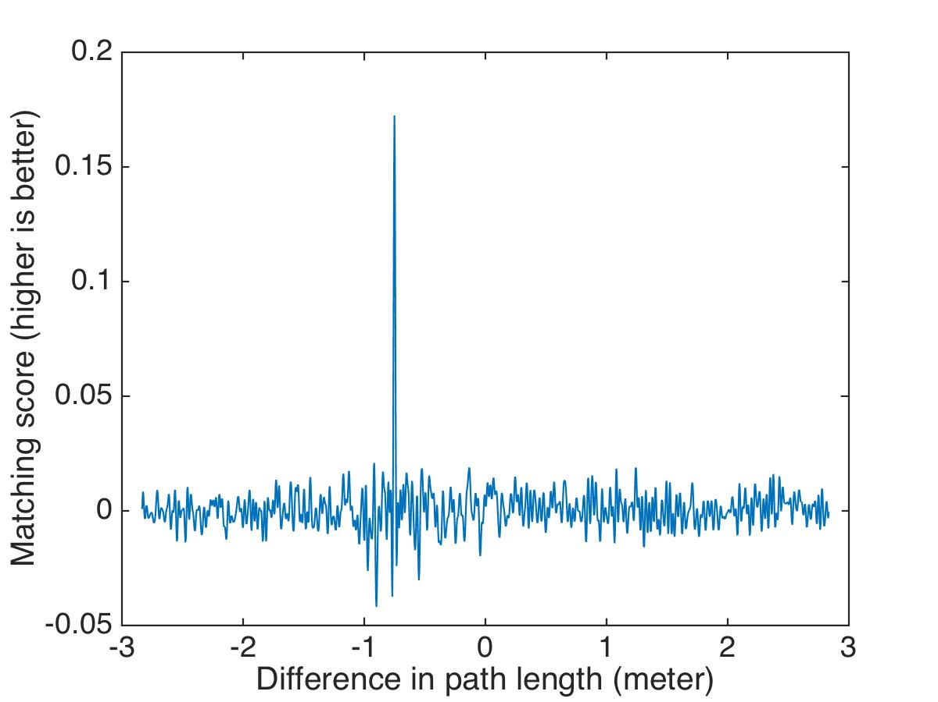
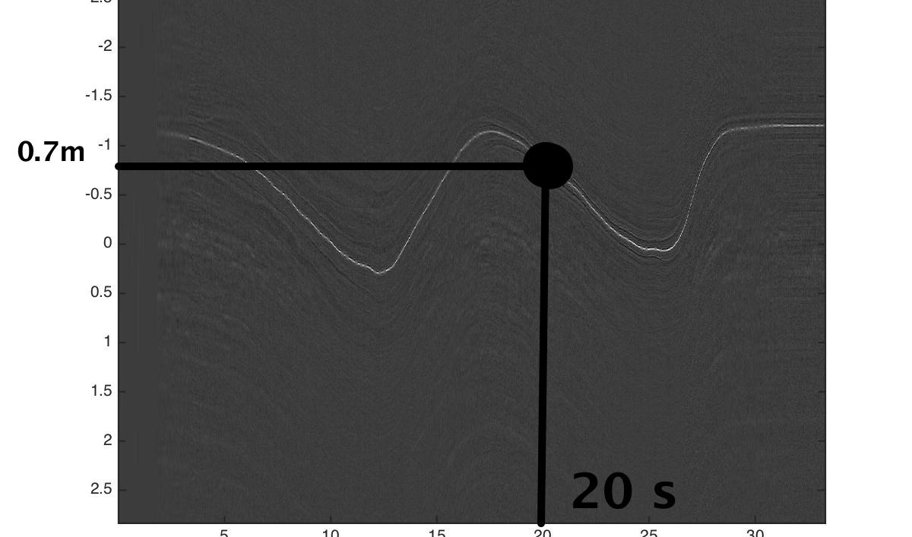
Compare channels 1 and 2
At every instant (e g at 20s) we can measure the fit for different relative distances.

Slide 9
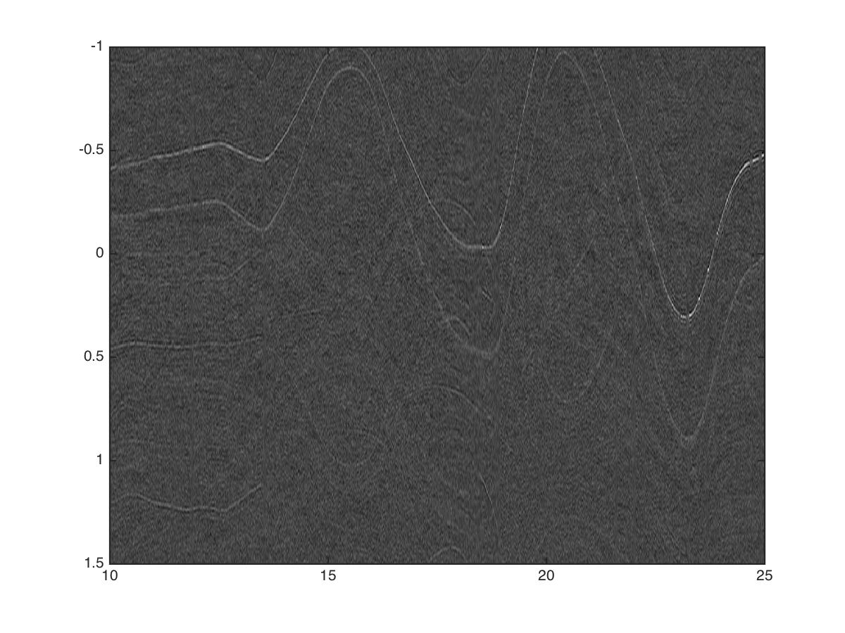
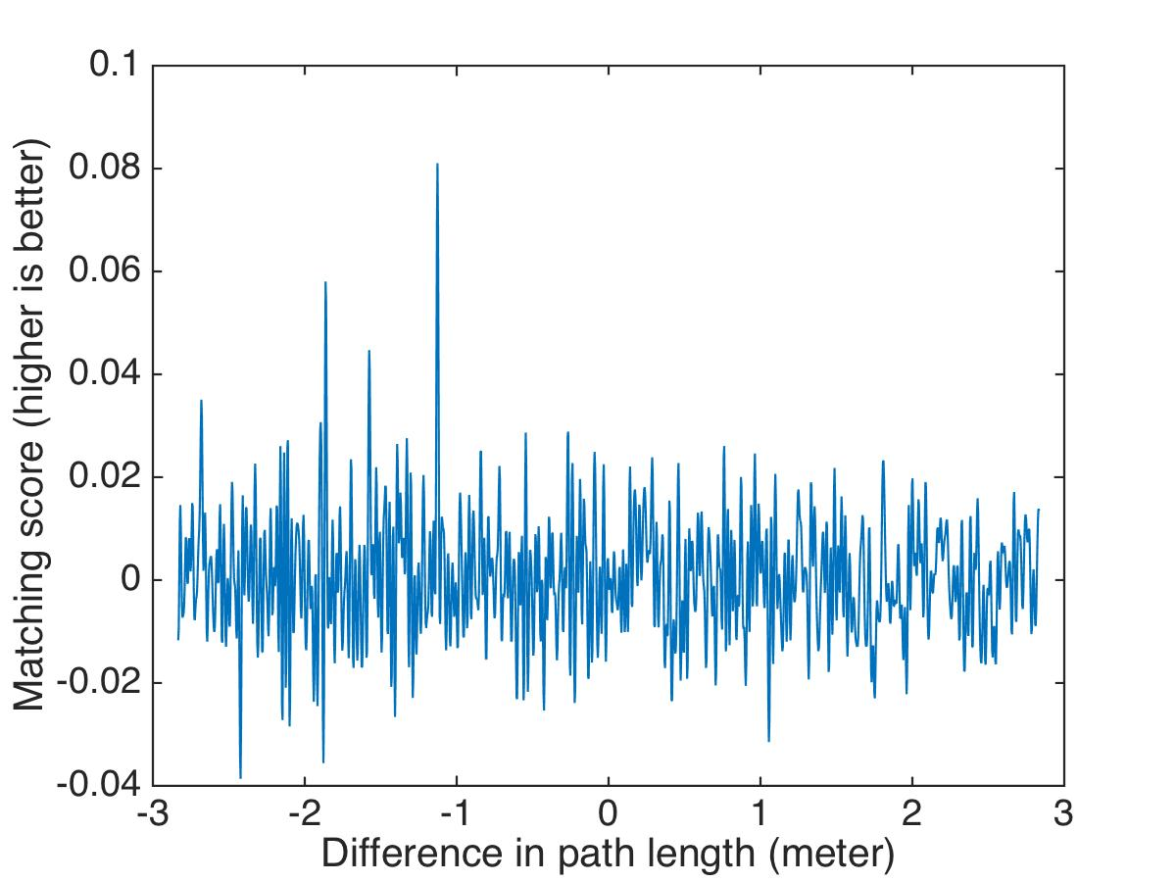
Example from the coffee room at the centre for mathematical sciences

Slide 10
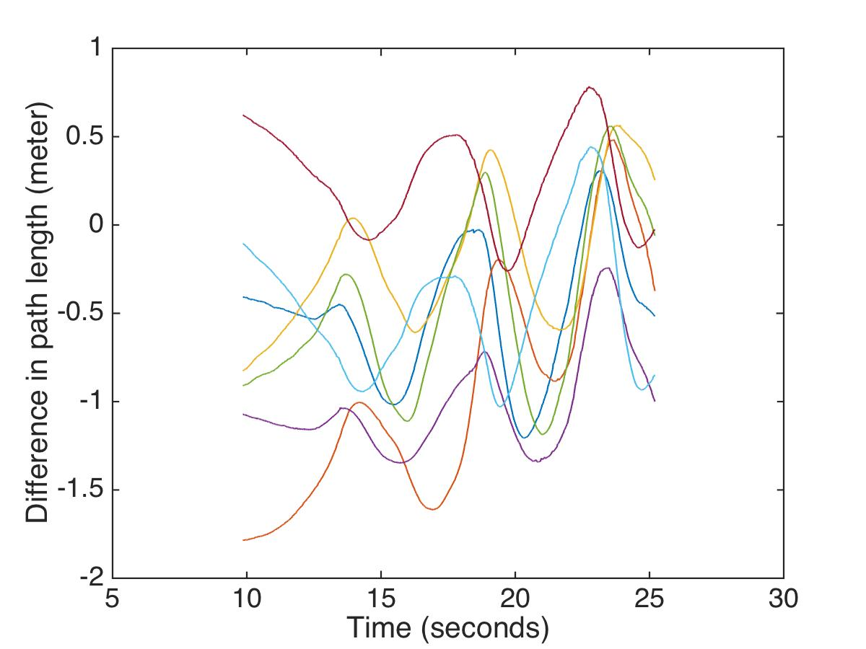
Robust methods for tracking -> tracks
-> TDOA structure from motion prob.

Slide 11
From tracks -> map
Ceiling
Wall
Floor

Slide 12
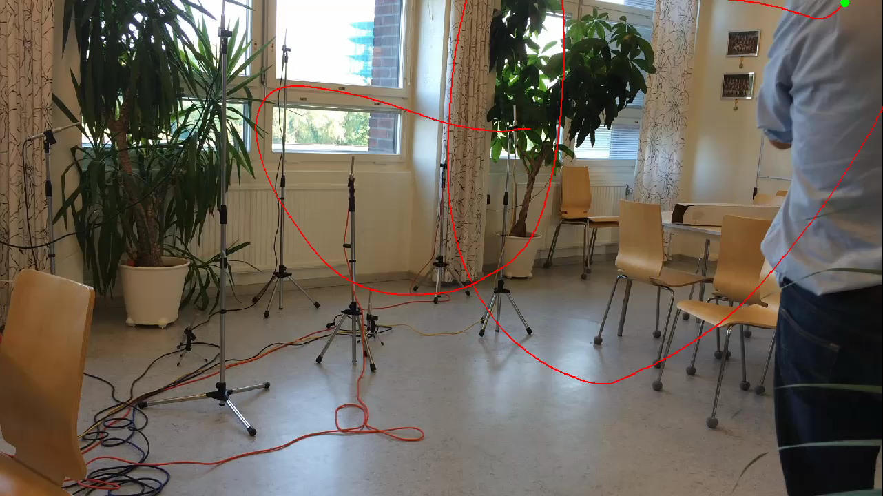
Overlay of sound source path in image.
(Errors ≈ 0.01 m)

Slide 13
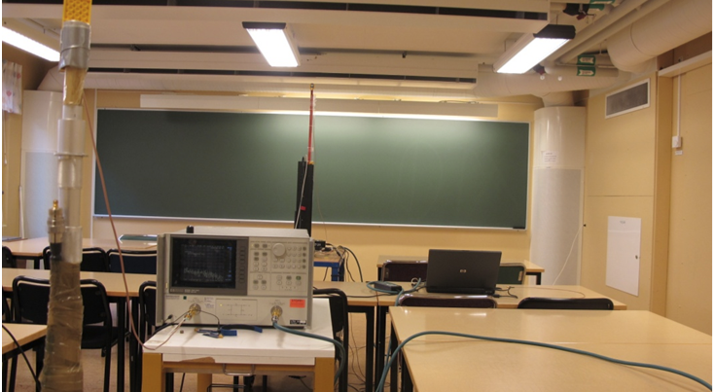
Radio
Kuang, Tufvesson, Åström: Single Antenna Anchor-Free UWB Positioning based on Multipath Propagation, IEEE International Conference on Communications, 2013.

Slide 14
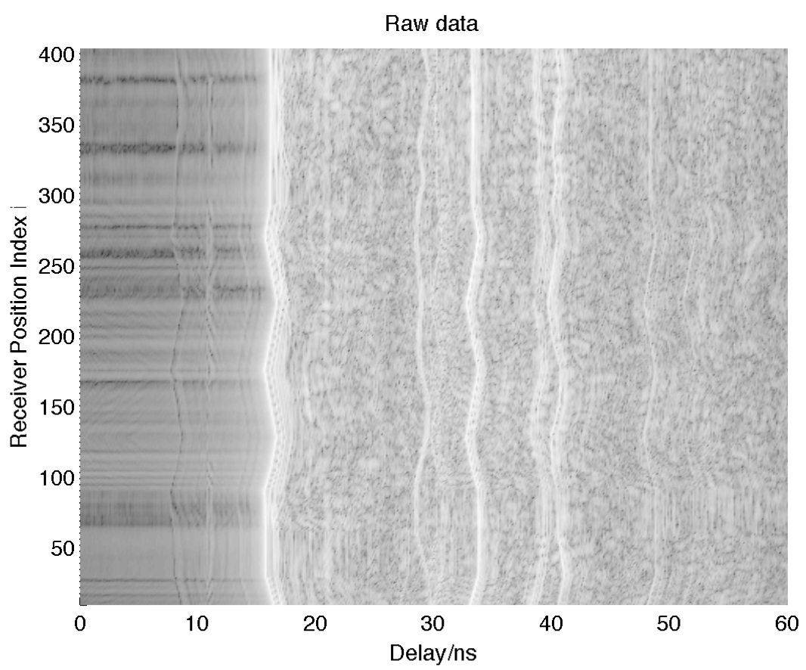

Slide 16
Map-making using radio TOA
(errors in the order of cm)

Slide 17
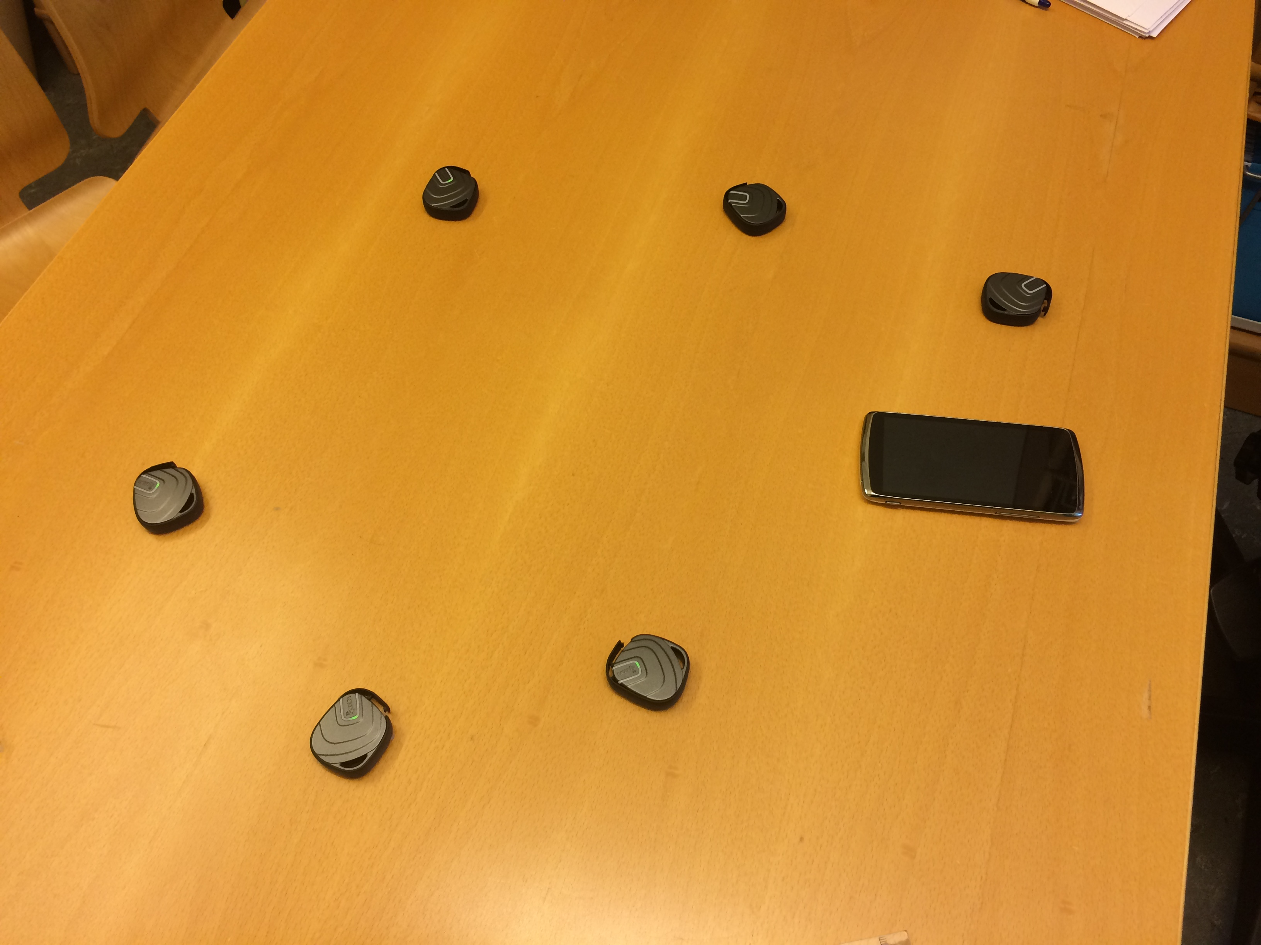

Slide 18
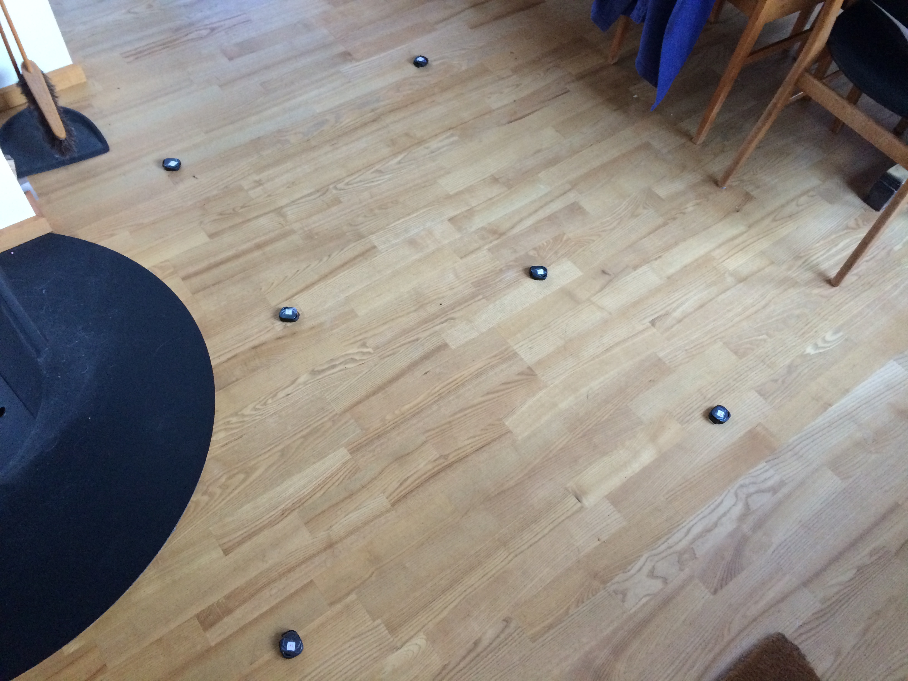

Slide 19
Map making using UWB-tags and mobile phone motion (errors ≈ 0.1 m)

Slide 20
Map making of wifi-positions and mobile phone positions (errors ≈ 10 m)
Previous methods
Vinnova funded project: Lund University and Combain Mobile AB (project nr 2014-00300)

Slide 21
Map making of wifi-positions and mobile phone positions (errors ≈ 10 m)
Estimation of both wifis and measurement positions using wifi signal strength
Previous methods
Vinnova funded project: Lund University and Combain Mobile AB (project nr 2014-00300)

Slide 22
Map making of wifi-positions and mobile phone positions (errors ≈ 10 m)
Estimation of both wifis and measurement positions using wifi signal strength
Ground Truth
Previous methods
Vinnova funded project: Lund University and Combain Mobile AB (project nr 2014-00300)

Slide 23
Minimal problems (Calibrated cameras)
Triangulation
  2 views, 1 point
  1 solution
  Pose (P3P problem)
  1 view, 3 points
  4 solutions
Structure from motion
  2 views, 5 point
  ”5 point algorithm”
  10 solutions

Slide 24
TOA geometry (Flatland)
Trilateration
  (cf. triangulation, pose)
Well known
2 solutions

Slide 25
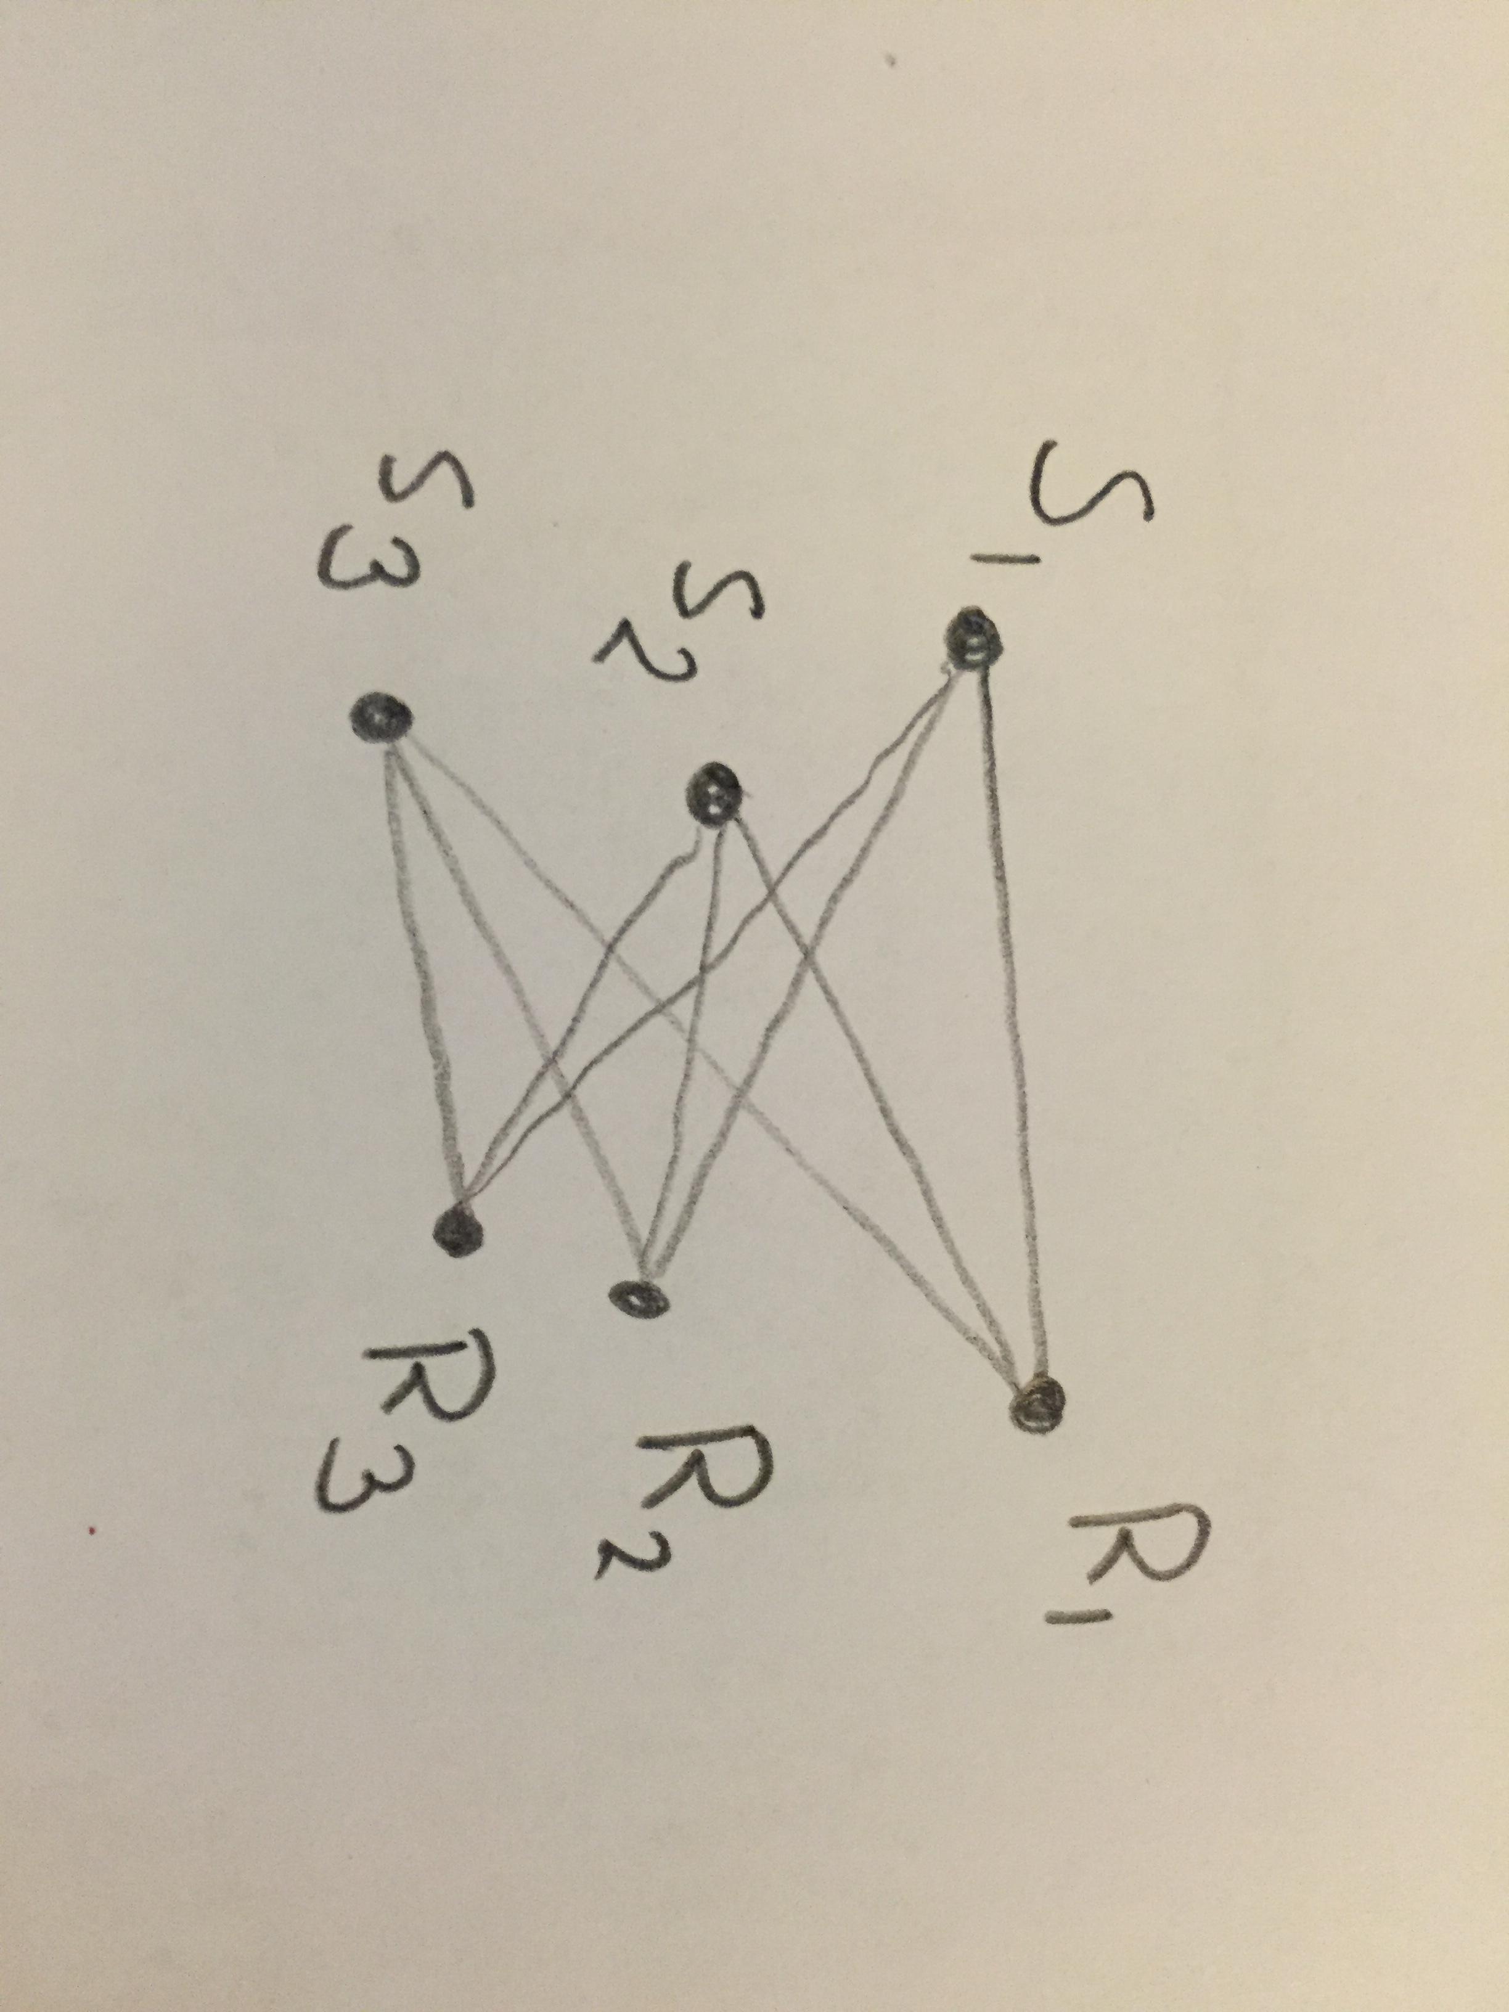
TOA geometry (Flatland)
Structure from motion
Minimal problem
  3 receivers
  3 senders
  (9 measurements)
  8 solutions
H. Stewénius. Gröbner Basis Methods for Minimal Problems in Computer Vision, 2005.
Y. Kuang et al, A Complete Characterization and Solution to the Microphone Position Self-Calibration Problem, ICASSP 2013.

Slide 26
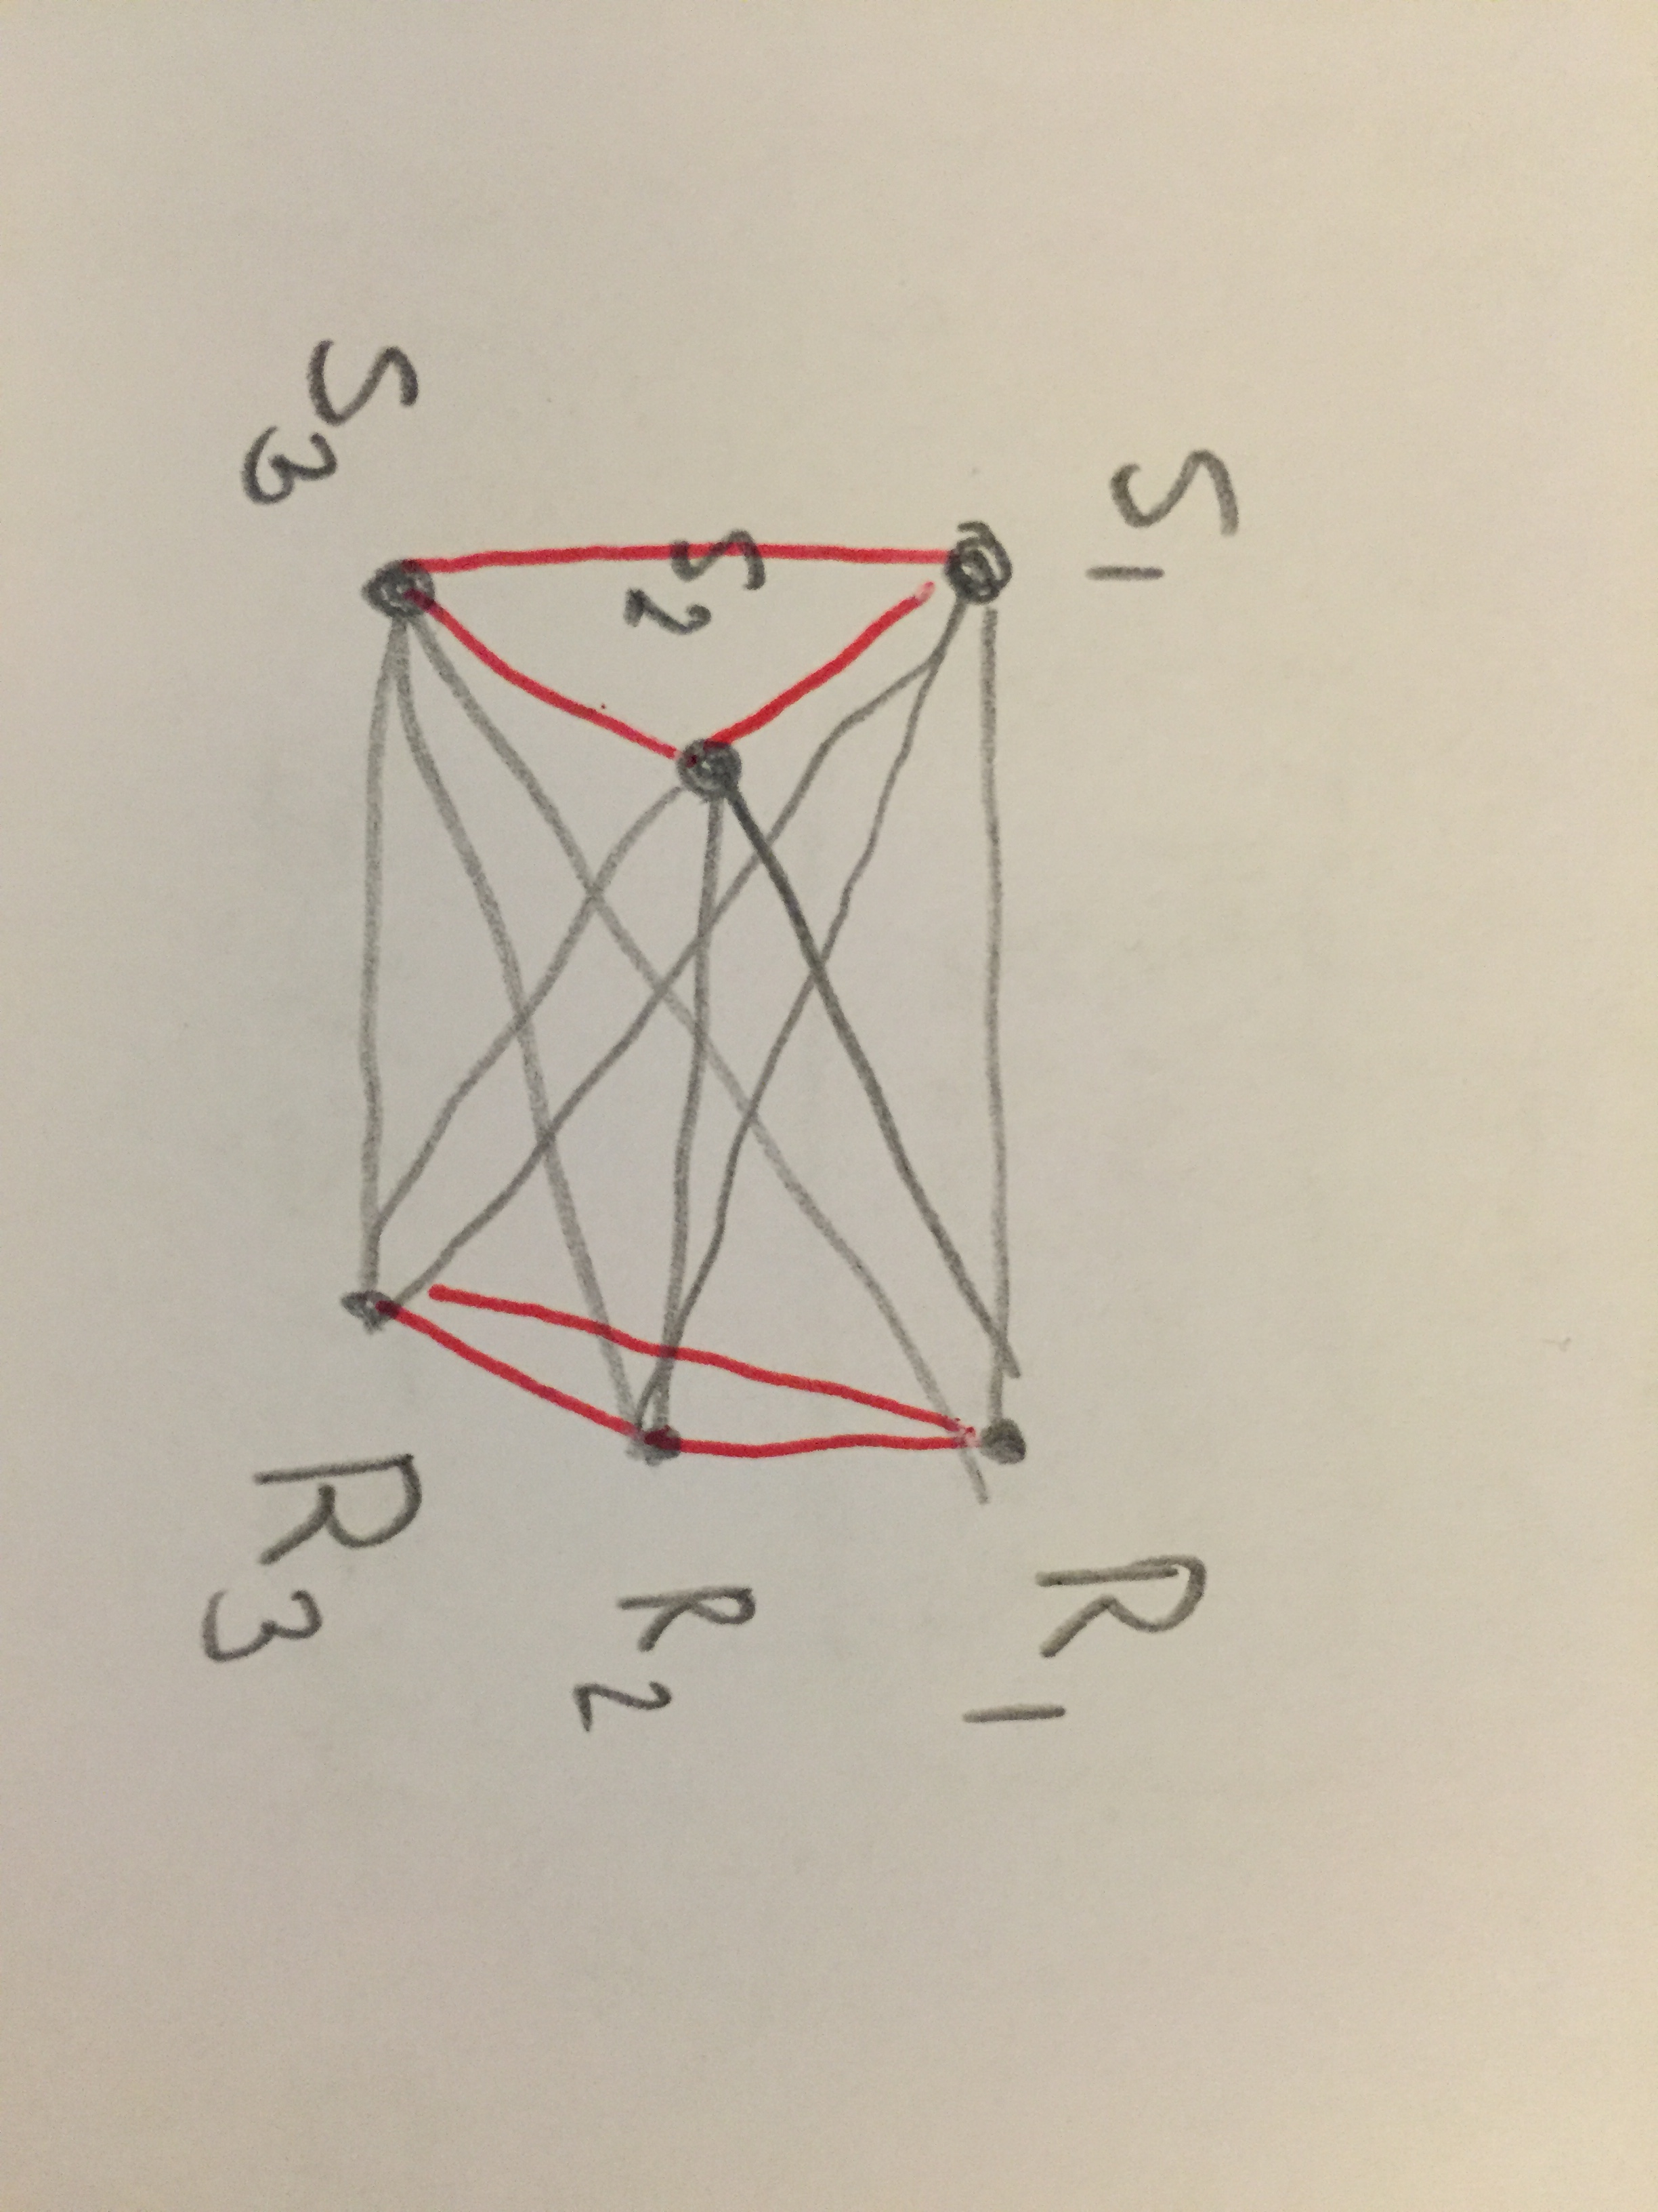
Multi-dimensional scaling
Relation to MDS
Multidimensional scaling
This assumes all distance measurements
G, Young, A. S. Householder, Discussion of a set of points in terms of their mutual distances, 1938.

Slide 27
Multi-dimensional scaling
Relation to MDS
Multidimensional scaling
This assumes all distance measurements
”TOA structure from motion is a special case of multi-dimensional scaling with missing data
G, Young, A. S. Householder, Discussion of a set of points in terms of their mutual distances, 1938.

Slide 28
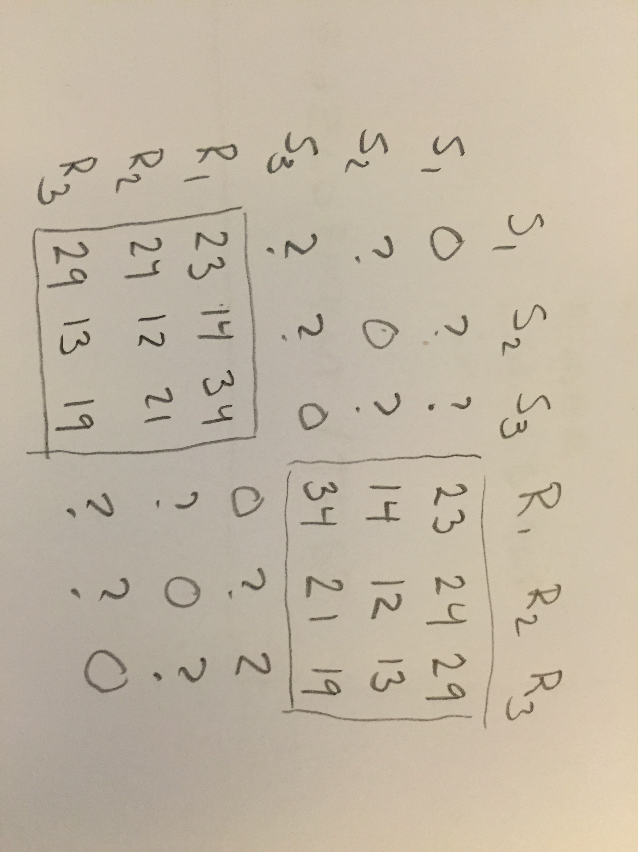
Multi-dimensional scaling
Relation to MDS
Multidimensional scaling
This assumes all distance measurements
”TOA structure from motion is a special case of multi-dimensional scaling with missing data

Slide 29
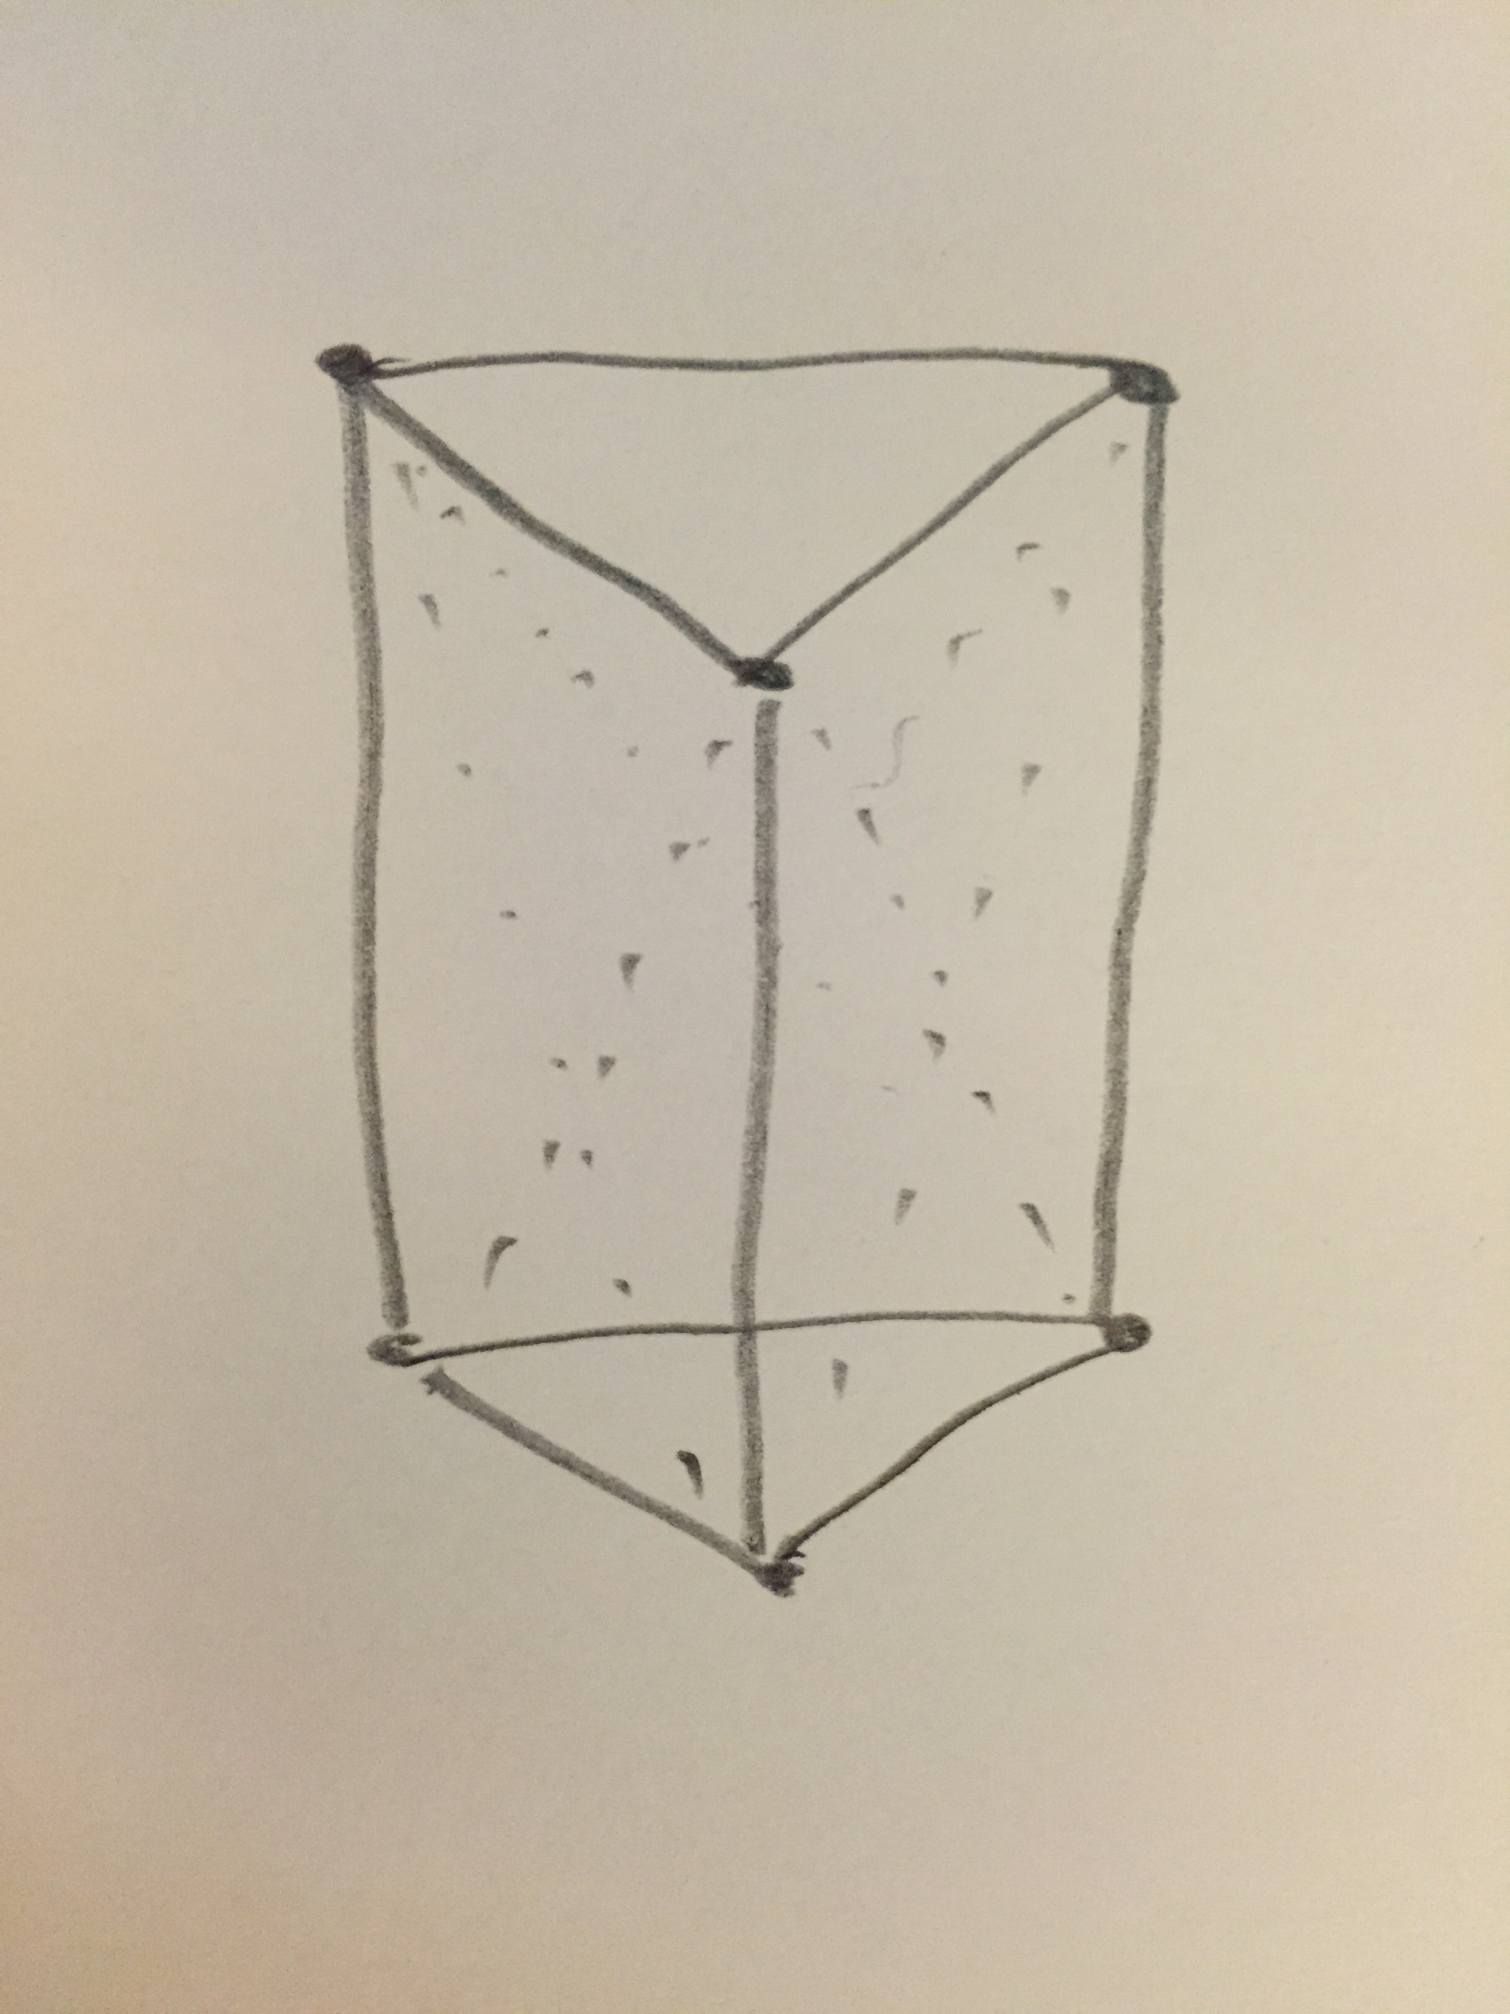
Rigid graphs (Flatland)
The general version of multi-dimensional scaling with missing data is studied within rigid graph theory
On reciprocal figures and diagrams of forces, Maxwell 1864
Recherche sur les polyèdres - premier mémoire, Cauchy 1813
M. Oskarsson, Prime Rigid Graphs and Multidimensional Scaling with Missing Data, ICPR 2014.

Slide 30
TOA geometry
In 3D
Minimal problems
  4 senders, 6 receivers
  5 senders, 5 receivers
  6 senders, 4 receivers
Y. Kuang et al, A Complete Characterization and Solution to the Microphone Position Self-Calibration Problem, ICASSP 2013.

Slide 31
TOA geometry, general dimensions
In k dimensions
m senders, n receivers
m >= k+1
n >= k+1
m+n >= 1 + k + k(k+1)/2
For example in 4D
  m+n>=15
Y. Kuang et al, A Complete Characterization and Solution to the Microphone Position Self-Calibration Problem, ICASSP 2013.

Slide 32
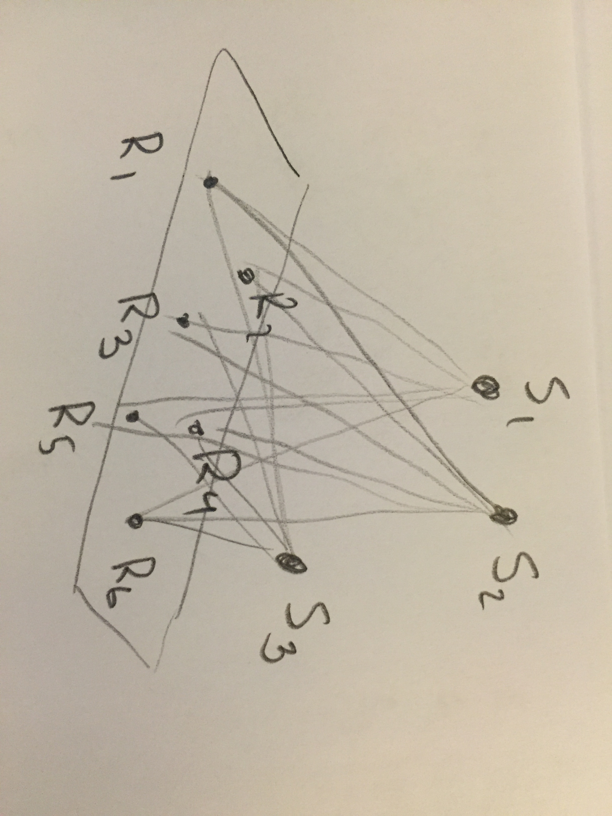
TOA – difference in dimensions
Problem changes character if one of the two point sets span a linear space with lower dimension
Receivers span dim k
Senders in dim k+1
m >= 1 + k + k(k+1)/2
n >= k+1
Essentially unique solution
S. Burgess et al, TOA sensor network self-calibration for receiver and transmitter spaces with difference in dimension, Signal Processing, 2015
.

Slide 33
TDOA geometry in 3D
I – Minimal problems
  Open problem
III – state-of the art solvers
Y. Kuang et al, Stratified Sensor Network Self-Calibration From TDOA Measurements, EUSIPCO 2013.

