Slide 1
Solving Minimal Problems
Symmetry
Kalle Åström, Centre for Mathematical Sciences,
Lund University, Sweden

Slide 2
Symmetry – Initial example
Study the problem in one variable
Although there are 6 solutions, there is a symmetry
For every solution x, there is a symmetric solution –x
Problem could be reduced to a smaller one.
In one variable it is easy to use variable substitution
Smaller degree (3 instead of 6), fewer solutions for the solver to find, faster, less memory, less numerical instability?

Slide 3
Symmetry – two variables
Example in two variables … Here all monomials are even
Although there are 4 solutions, there is a symmetry.
For every solution (x,y), there is a symmetric one (-x,-y).
Problem could be reduced to a smaller one.
In several variable it is difficult to use variable substitution
Questions:
  How can we detect that a system has symmetry?
  What kinds of symmetry can we use?
  How is symmetry exploited in practice?

Slide 4
Symmetry
Monomial
Using multi-index notation
Study multi-indices (as columns) of first equation:
Sum of multi-indices are all even.

Slide 5
Symmetry
If sum of multi-indices are all even (or all are odd) then
  If x is a solution then –x is a solution
Generalizations
  1. Works for higher order symmetries. Statement: If ’sum of multi-indices have the same remainder when divided by p’, then if x is a solution, then
  is also a solution.
  2. Works for symmetries on only some of the unknowns
  3. Statement is basically invertible, i e if there is a symmetry then ’sum of multi ….’ holds. (kind-of ☺)

Slide 6
Summary of partial symmetry

Slide 7
Practicalities
To make a solver:
Rewrite the equations so that they are all even (or all odd) in the symmetric variables.
Expand the equations by multiplying with monomials that are even, e g
Choose a multiplication-monomial that is even! In the symmetric variables, for example
Choose half as many basis monomials (the half that are even in the symmetric variables).
GO!

Slide 8
One more generalization
Optimal PnP for orthographic cameras.
Four-symmetry for the quaternions

Slide 9
One more generalization
After change of variables
We get
  Symmetry of order 2 in variables
  Symmetry of order 2 in variables
Rewrite the equations so that they are all even (or all odd) in the symmetric variables.
Expand the equations by multiplying with monomials that are even, e g
Choose a multiplication-monomial that is even! In the symmetric variables, for example
Choose one fourth of the basis monomials (the fourth that are even in both sets of symmetric variables). 32->8

Slide 10
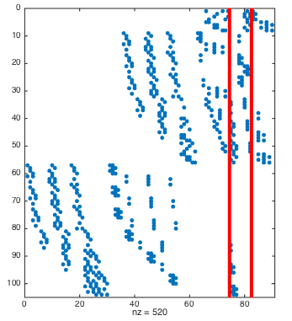

Slide 11
